Slide 1
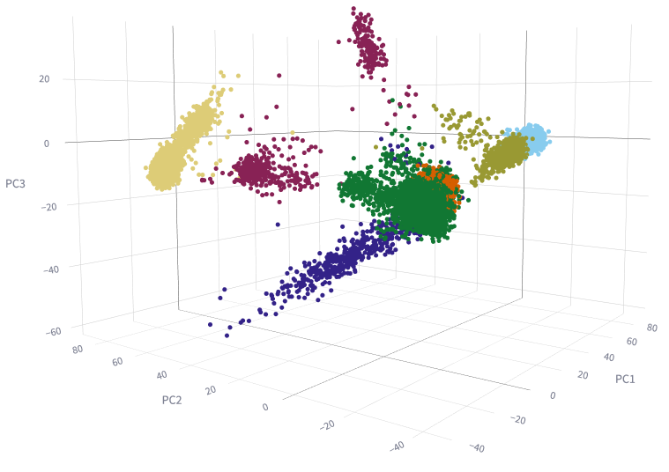
Supplementary Figure 1: Ancestry prediction model for target data. Three-dimensional principal components analysis (PCA) was performed to group individuals based on their genetic makeup. Each dot in the figure represents a sample, and the colors depict the ancestral background, as indicated in the color legend.
AFR: African
AAC: African Admixed
EUR: European
AMR: Latino/Admixed American
AJ: Ashkenazi Jewish
CAS: Central Asian
EAS: East Asian

Slide 2
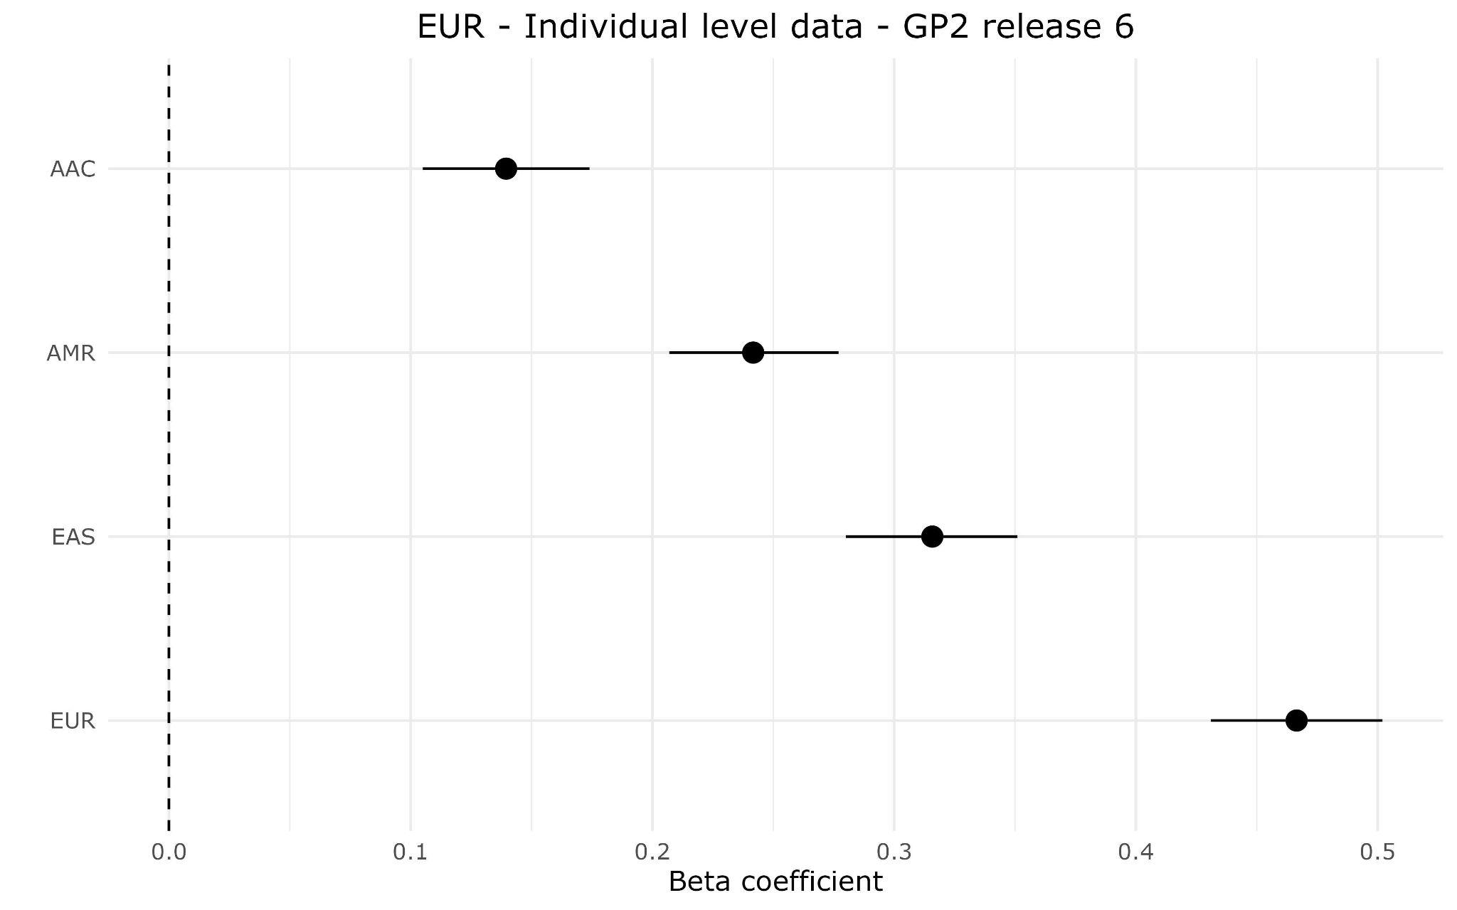
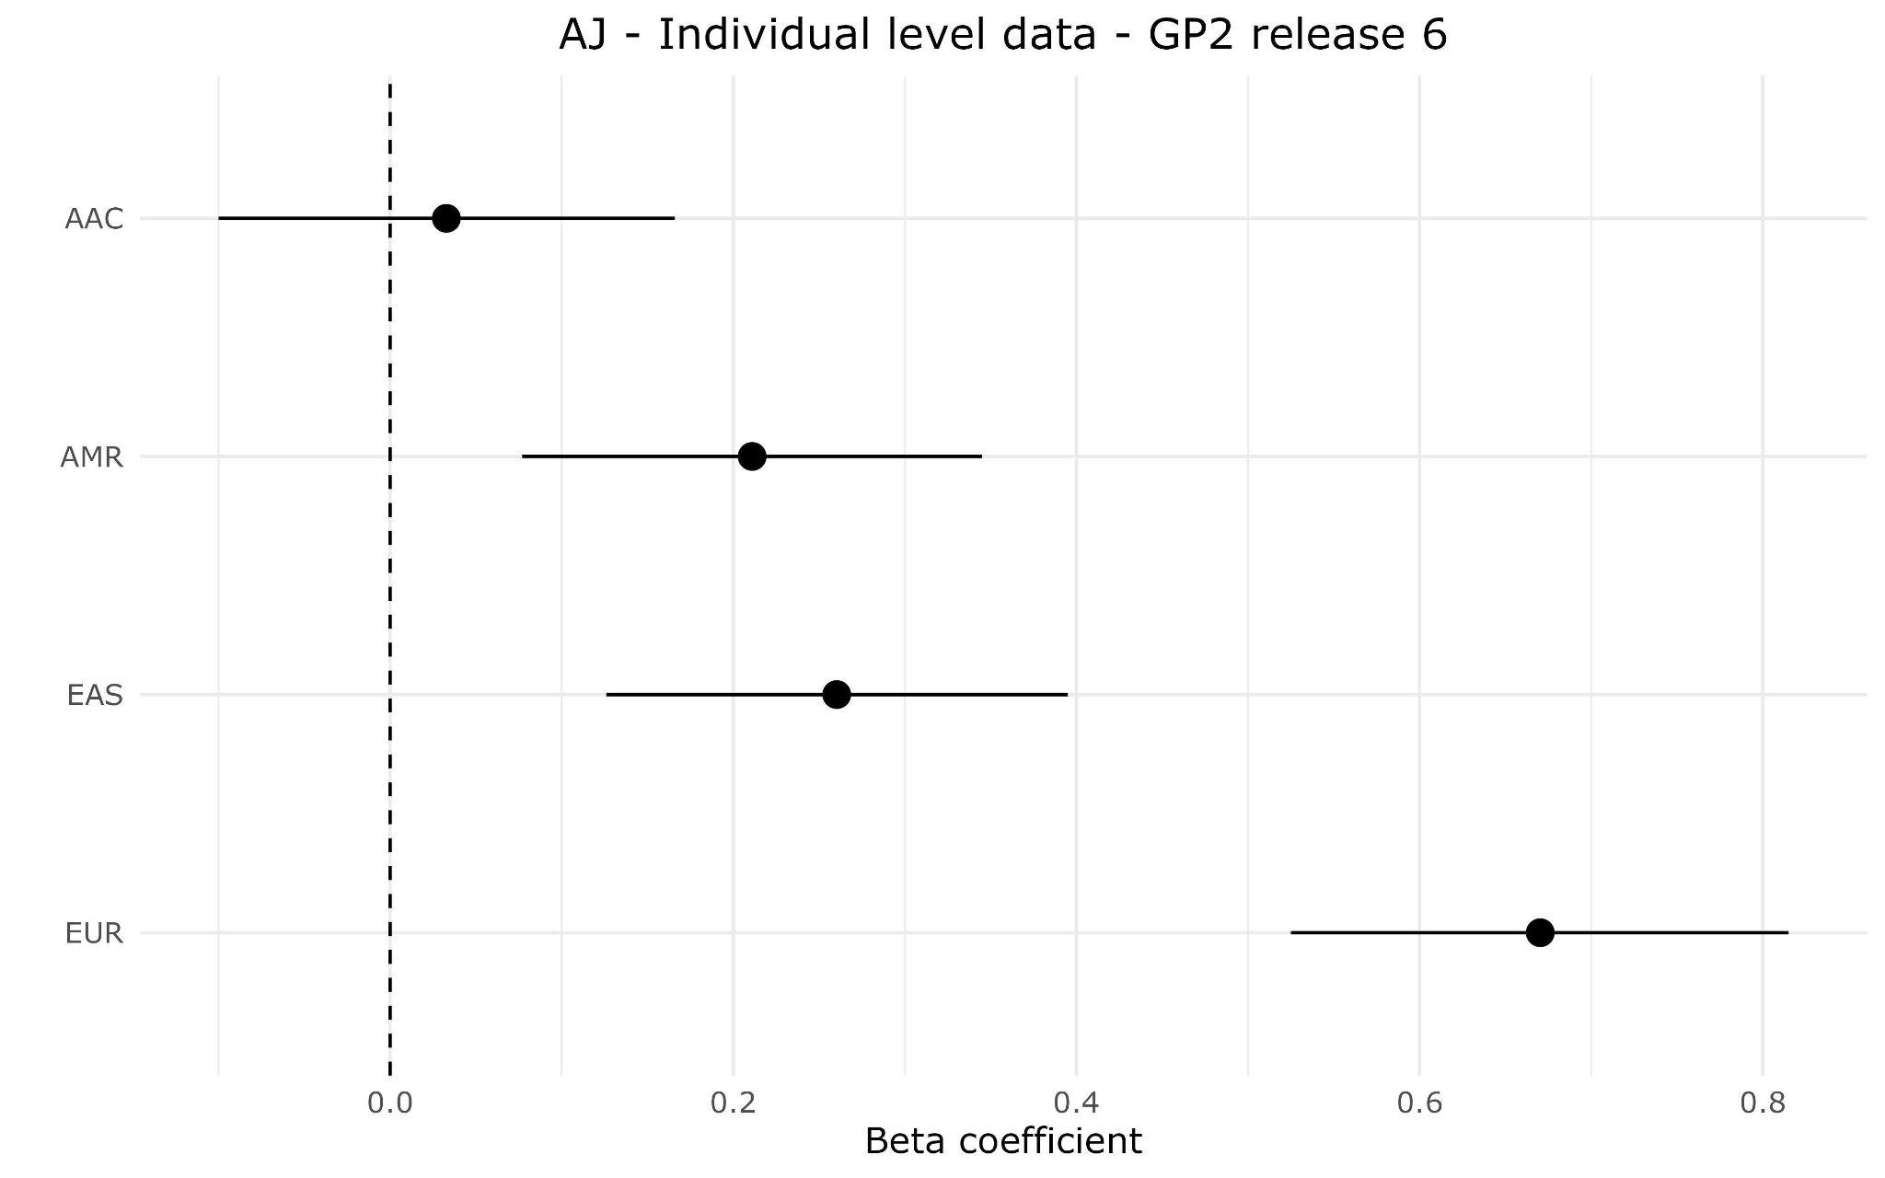
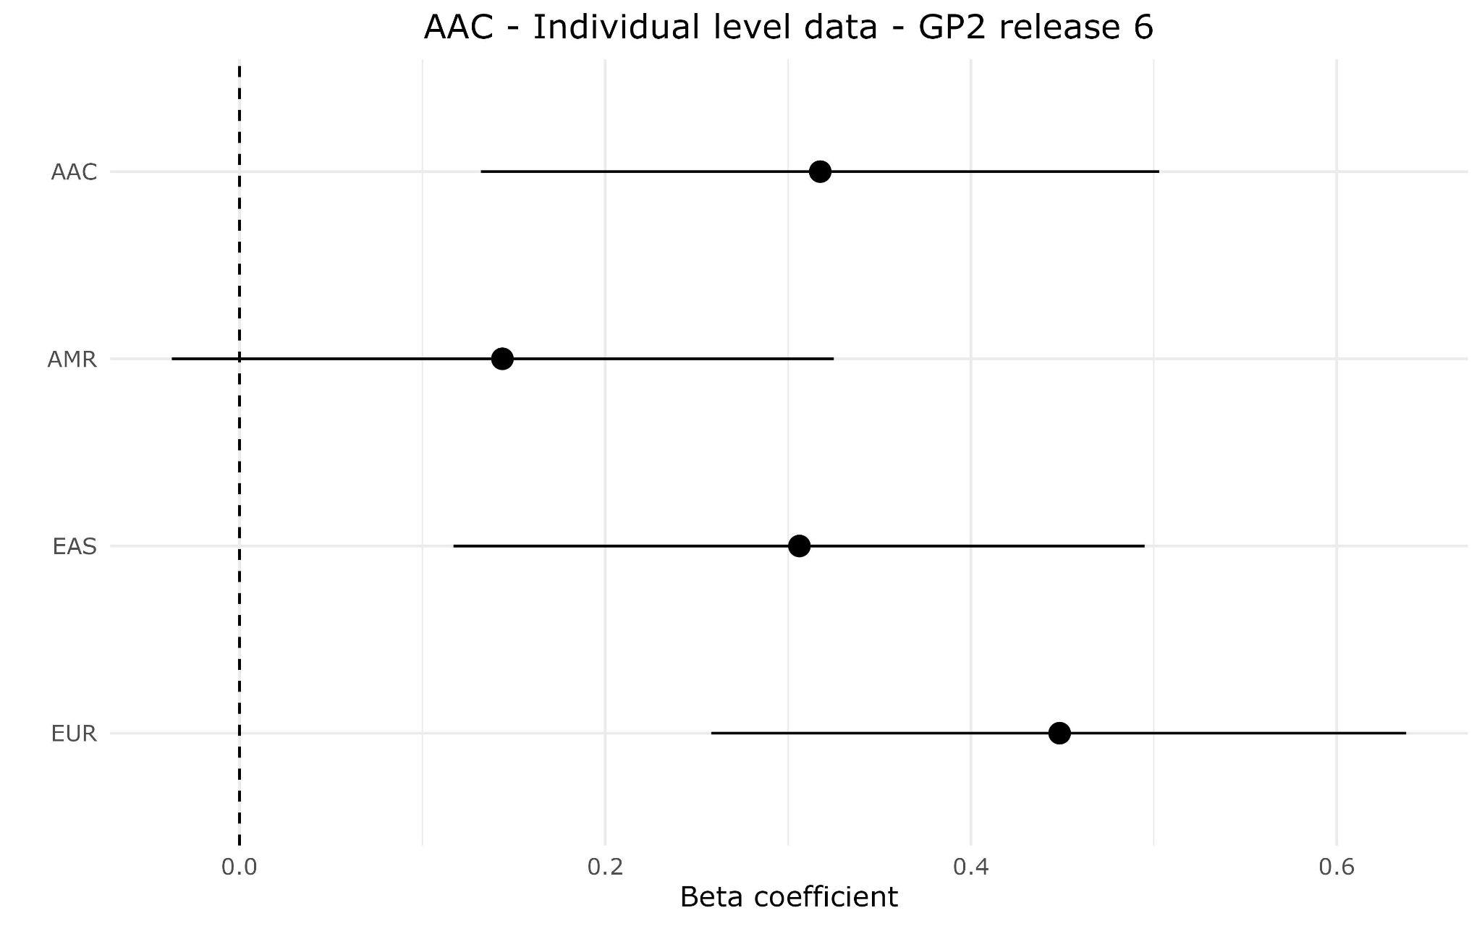
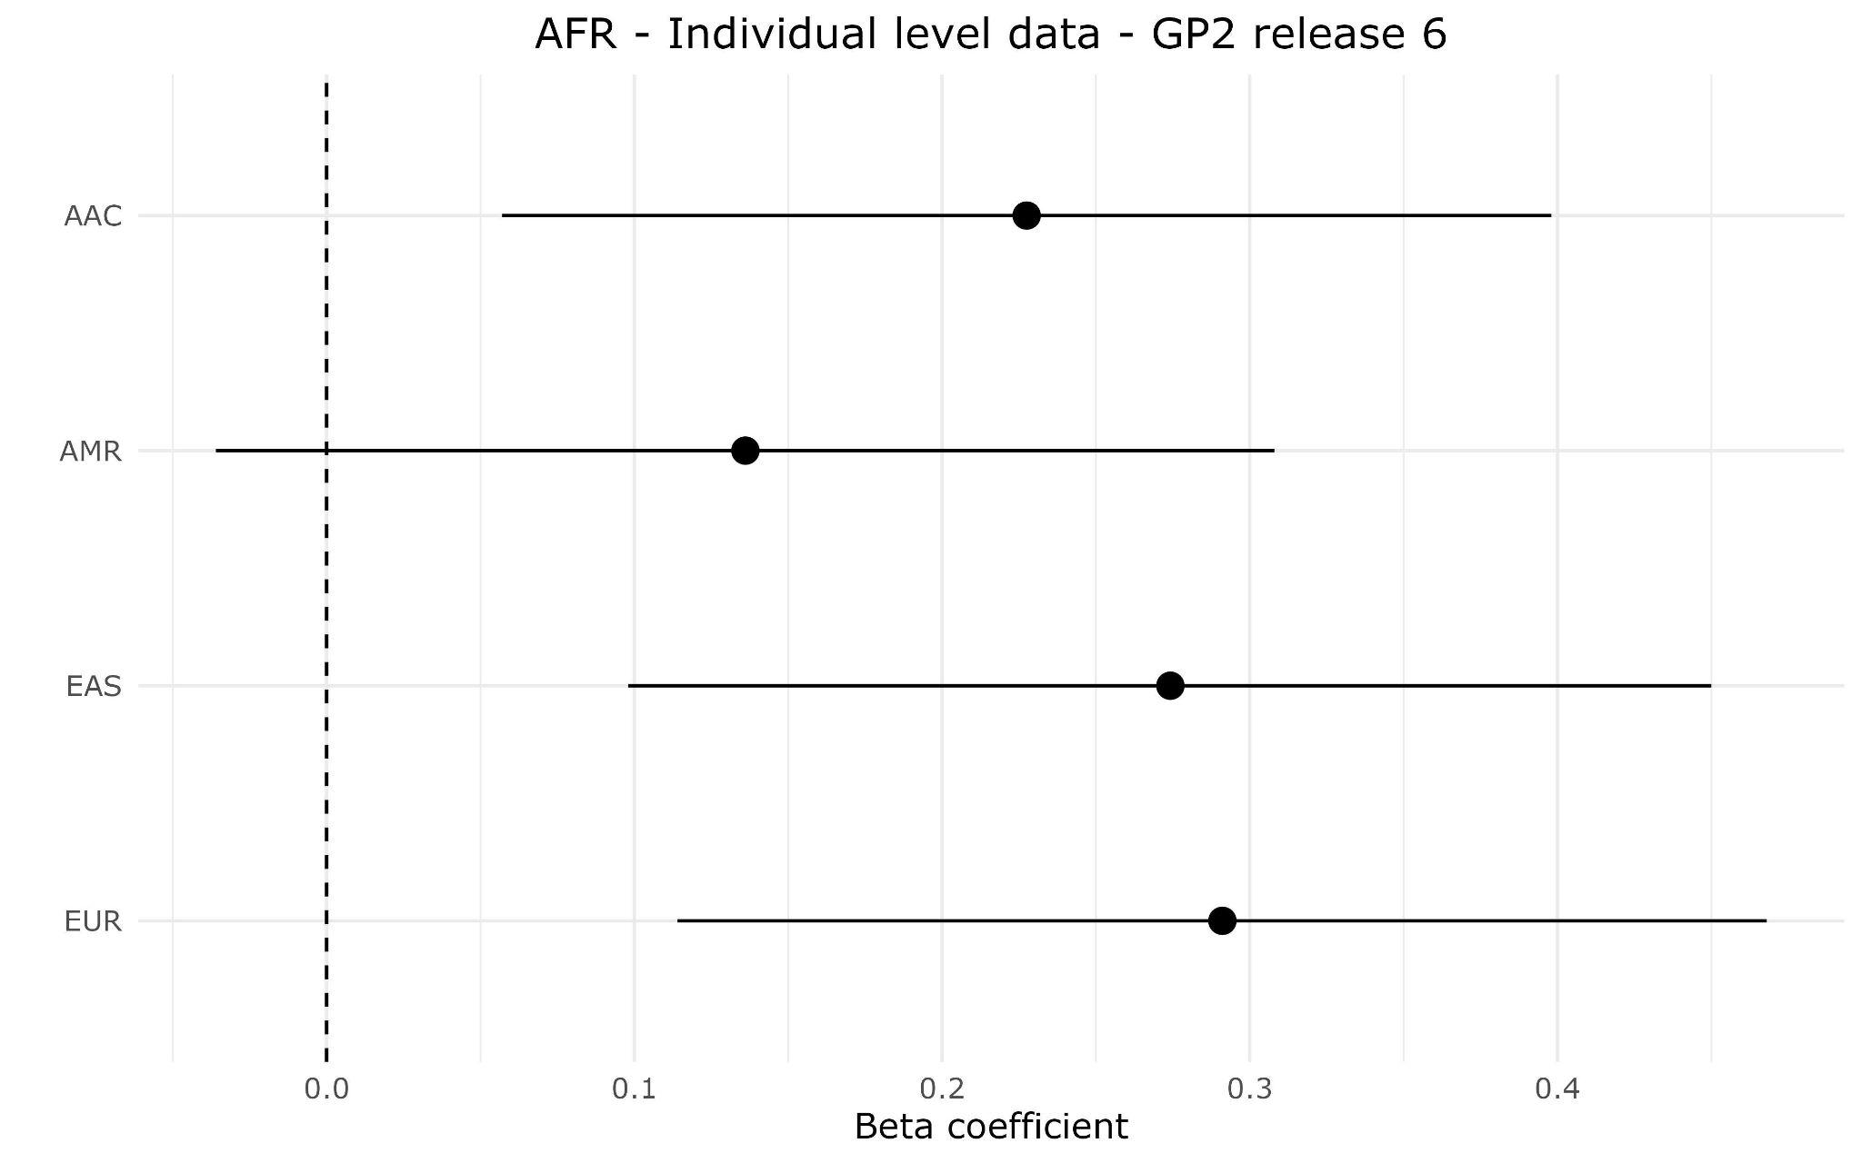
EUR
AJ
Supplementary Figure 2a: Magnitude of effect across ancestries
Forest plots comparing the effectiveness of disease prediction across the studied ancestries. Each panel specifically contrasts individual-level data with the population-specific summary statistics: European (EUR), East Asian (EAS), Latino Admixed (AMR), and African Admixed (AAC). On the plots, the x-axis represents the magnitude of effect, the y-axis lists the summary statistics for each group. The dots symbolize the value of the beta coefficient, and horizontal lines depict confidence intervals.
AAC
AFR
Notes:
Forest plots comparing the effectiveness of disease prediction across the 7 studied ancestries Each panel specifically contrasts individual-level data with the four population-specific summary statistics: European (EUR), East Asian (EAS), Amerindian (AMR), and African Ancestry (AAC), respectively. On the plots, the x-axis represents the magnitude of effect, the y-axis lists the summary statistics for each group. The dots symbolize the value of the beta coefficient, the horizontal lines extending from each dot depict confidence intervals.

Slide 3
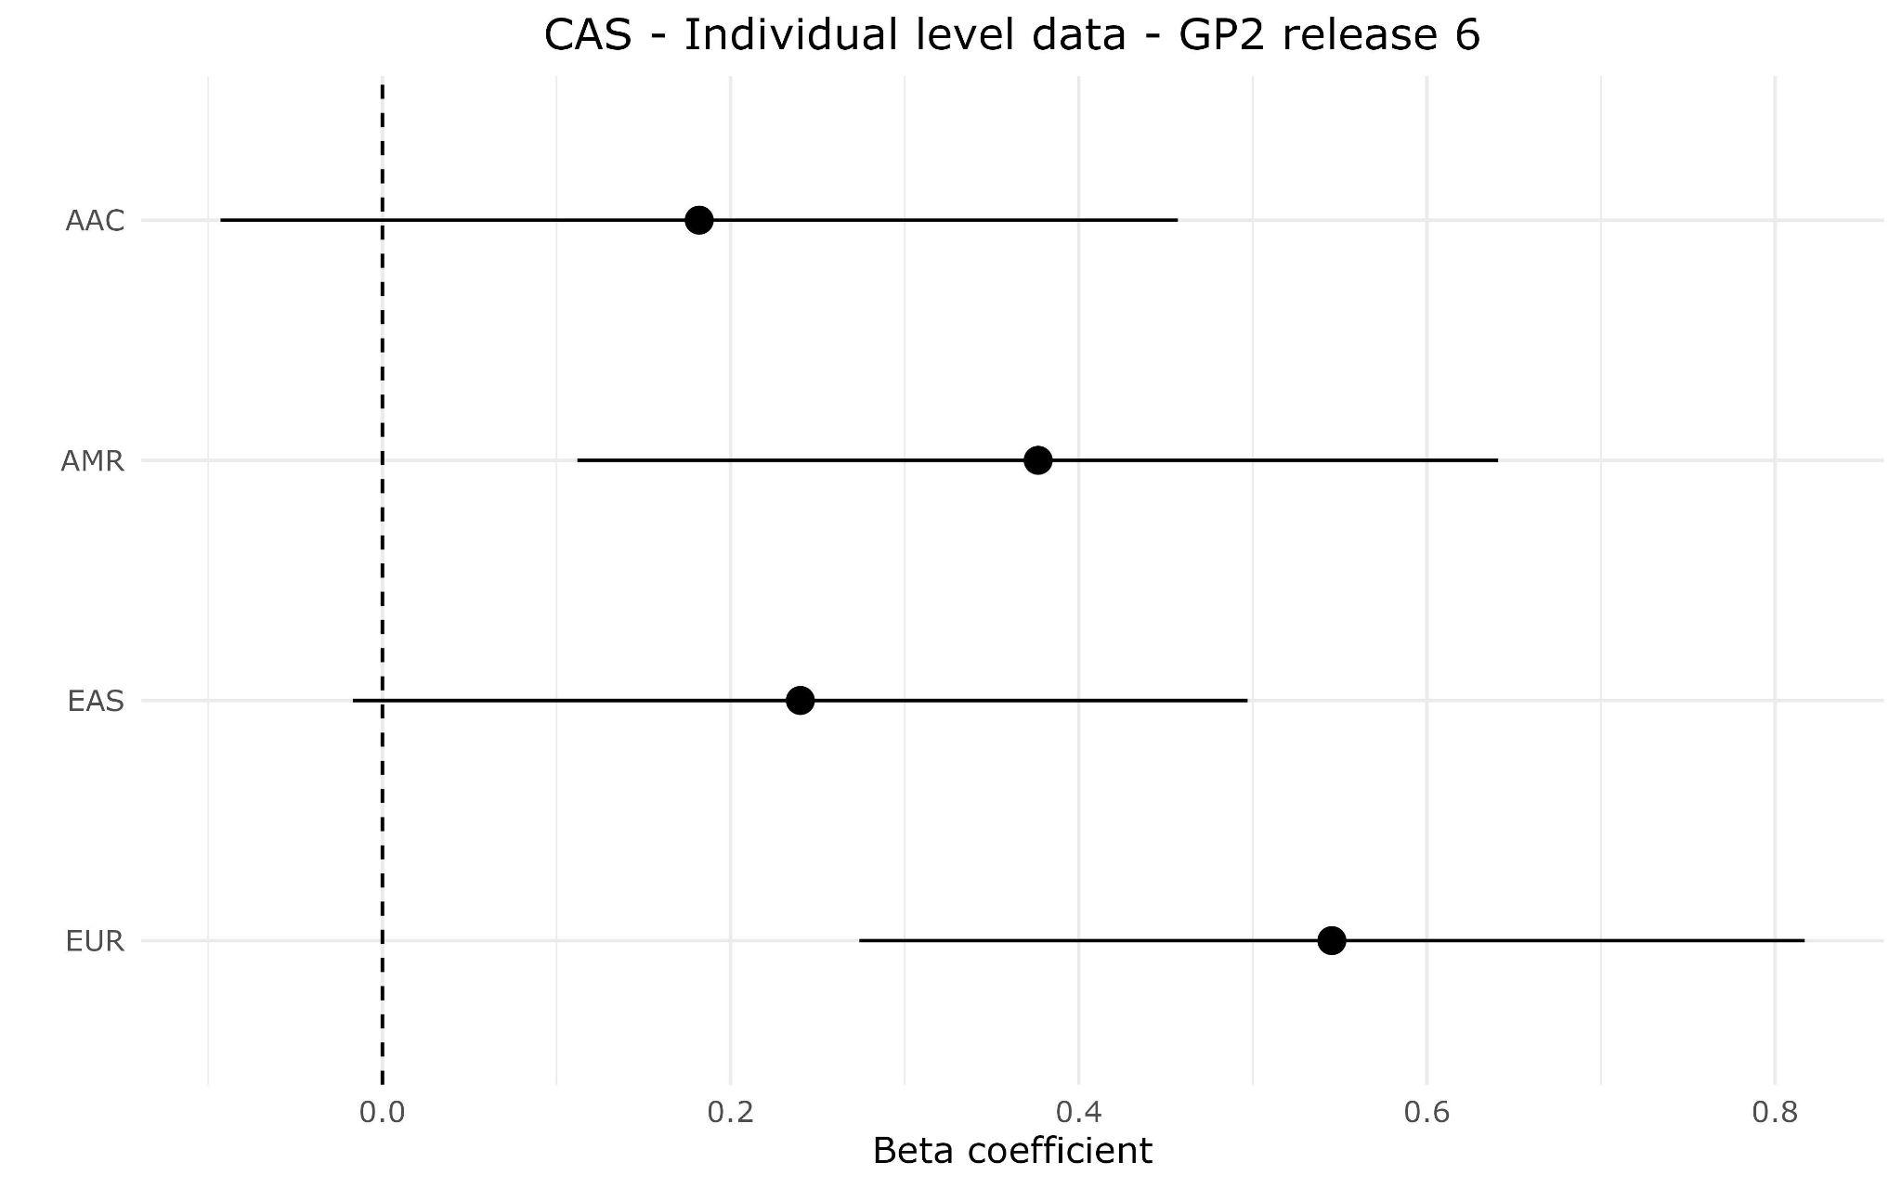
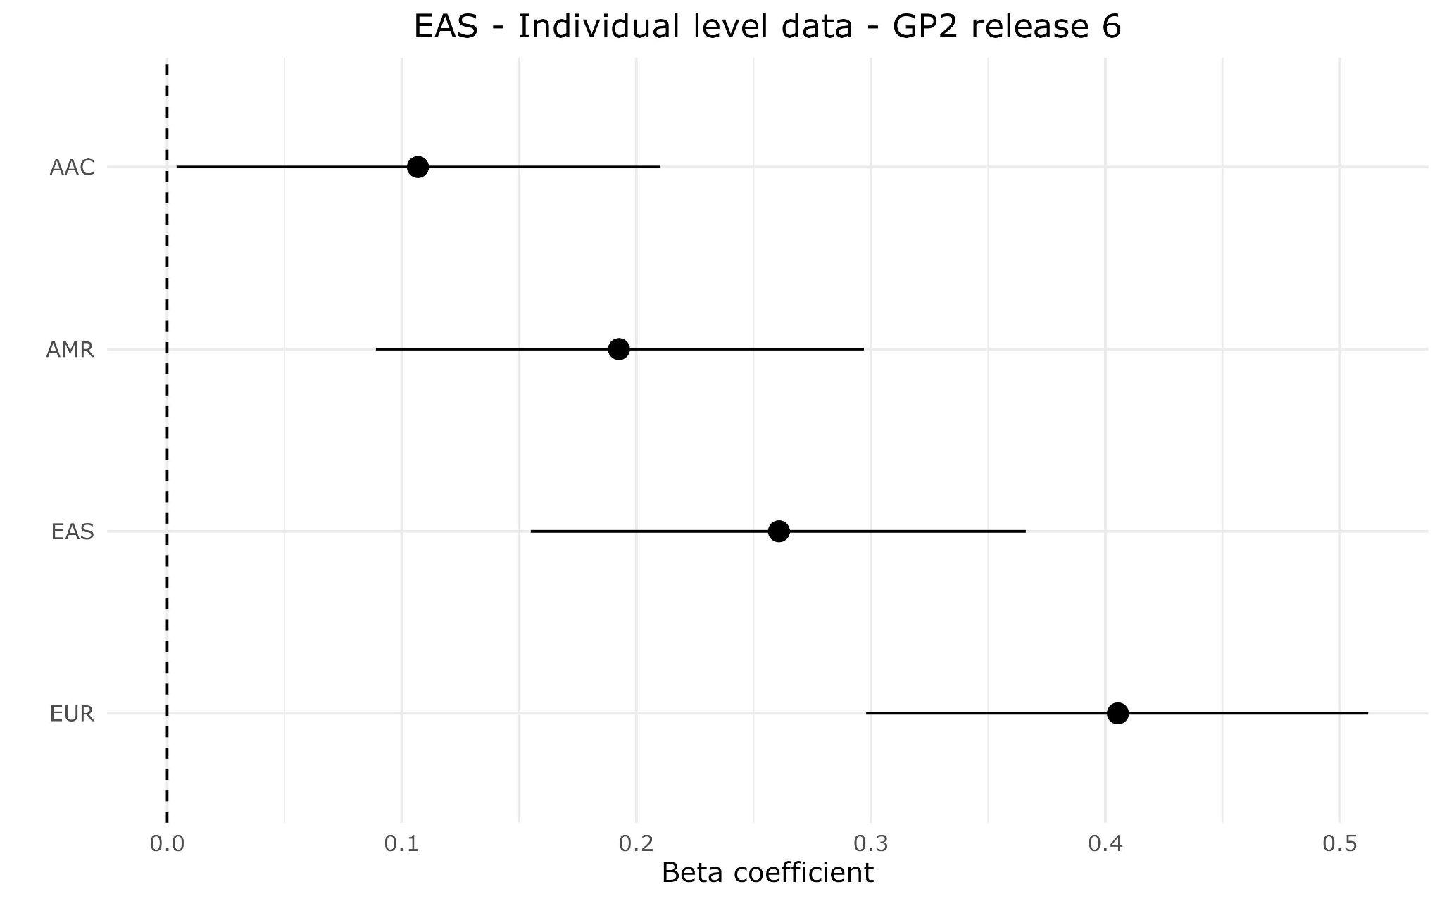
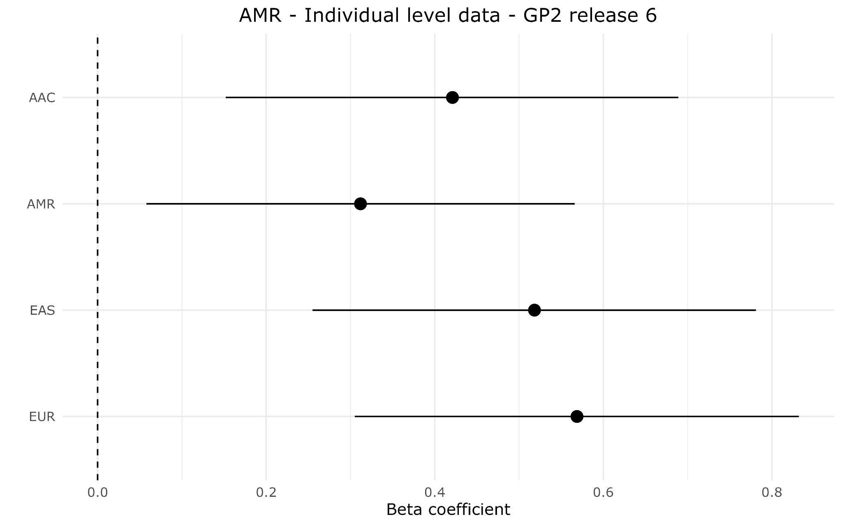
CAS
EAS
AMR
Supplementary Figure 2b: Magnitude of effect across ancestries
Forest plots comparing the effectiveness of disease prediction across the studied ancestries. Each panel specifically contrasts individual-level data with the population-specific summary statistics: European (EUR), East Asian (EAS), Latino Admixed (AMR), and African Admixed (AAC). On the plots, the x-axis represents the magnitude of effect, the y-axis lists the summary statistics for each group. The dots symbolize the value of the beta coefficient, and the horizontal lines depict confidence intervals.

Slide 4
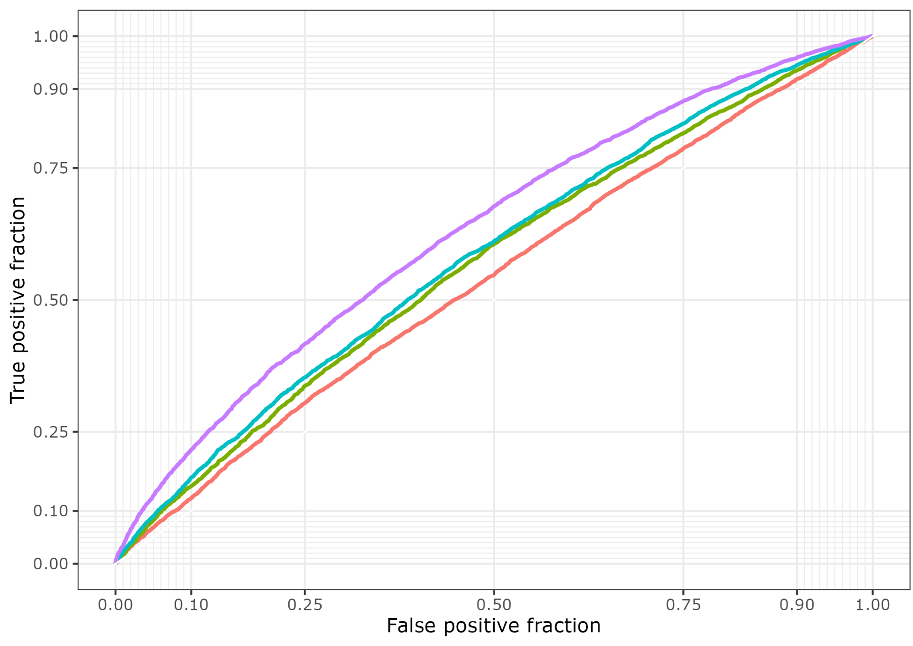
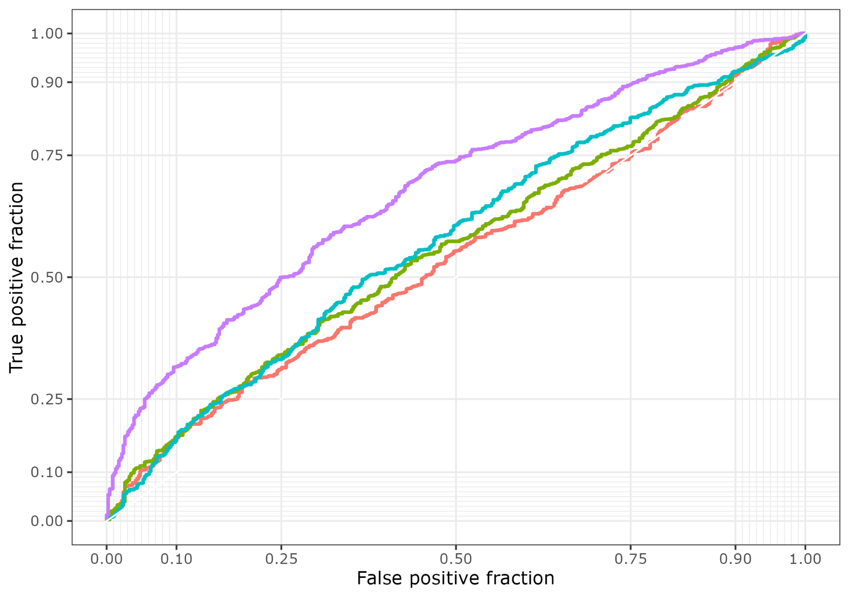
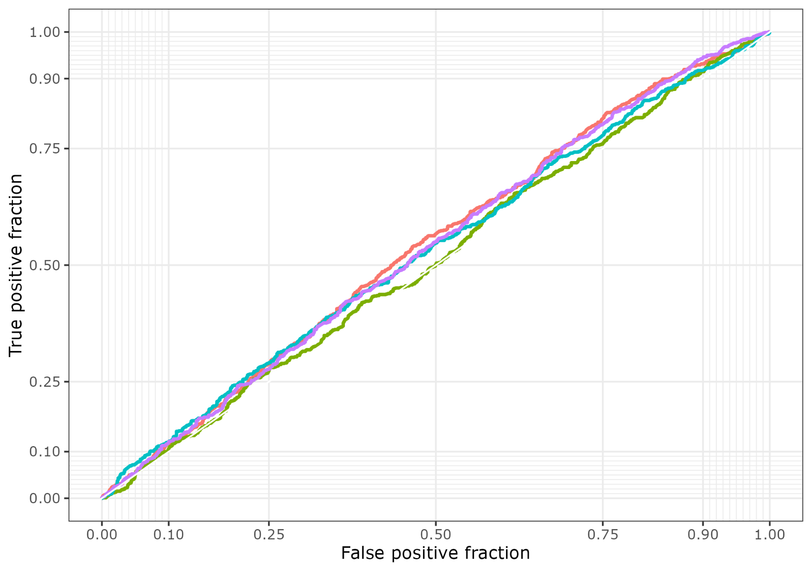
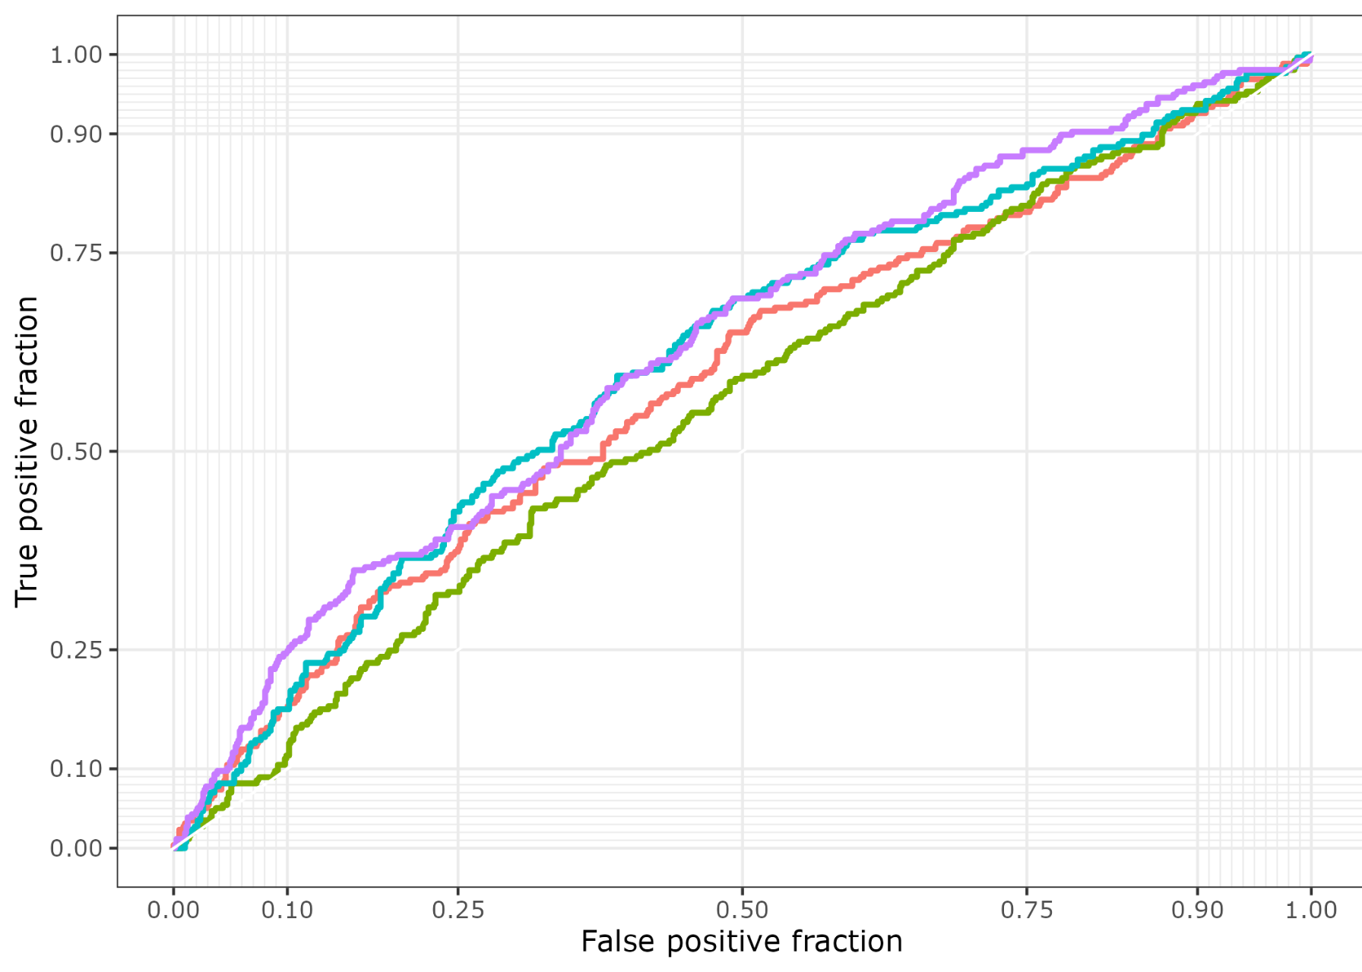
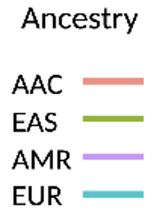
EUR
AJ
Supplementary Figure 3a: Polygenic risk score model performance evaluation
The ROC curve depicts an evaluation of the PRS model's performance for each target data population when using the 4 population-specific summary statistics and the multi-ancestry PD summary statistics. Each panel represents a comparison of individual-level data. The true positive rate is plotted on the Y axis against the false positive rate on the X axis. The sensitivity of the model increases with increasing Y value. The specificity (1-specificity) of the model decreases as the X value increases. Each population-specific PRS summary statistics is represented as a curve.
AFR
AAC

Slide 5
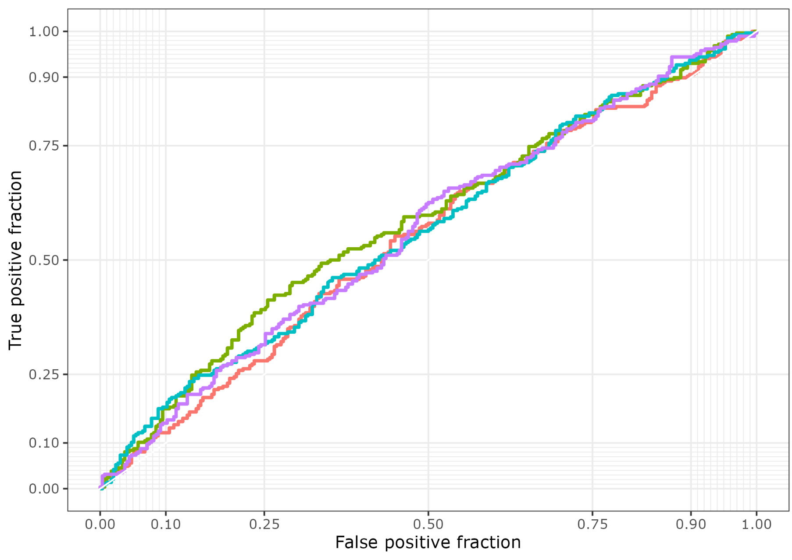
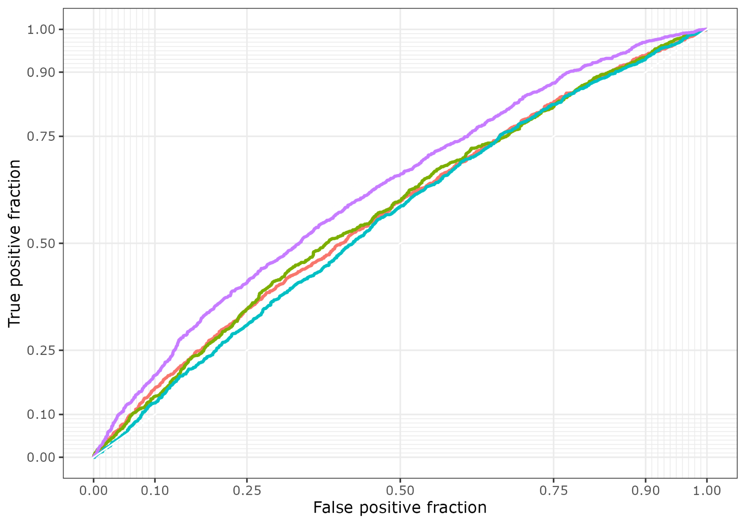
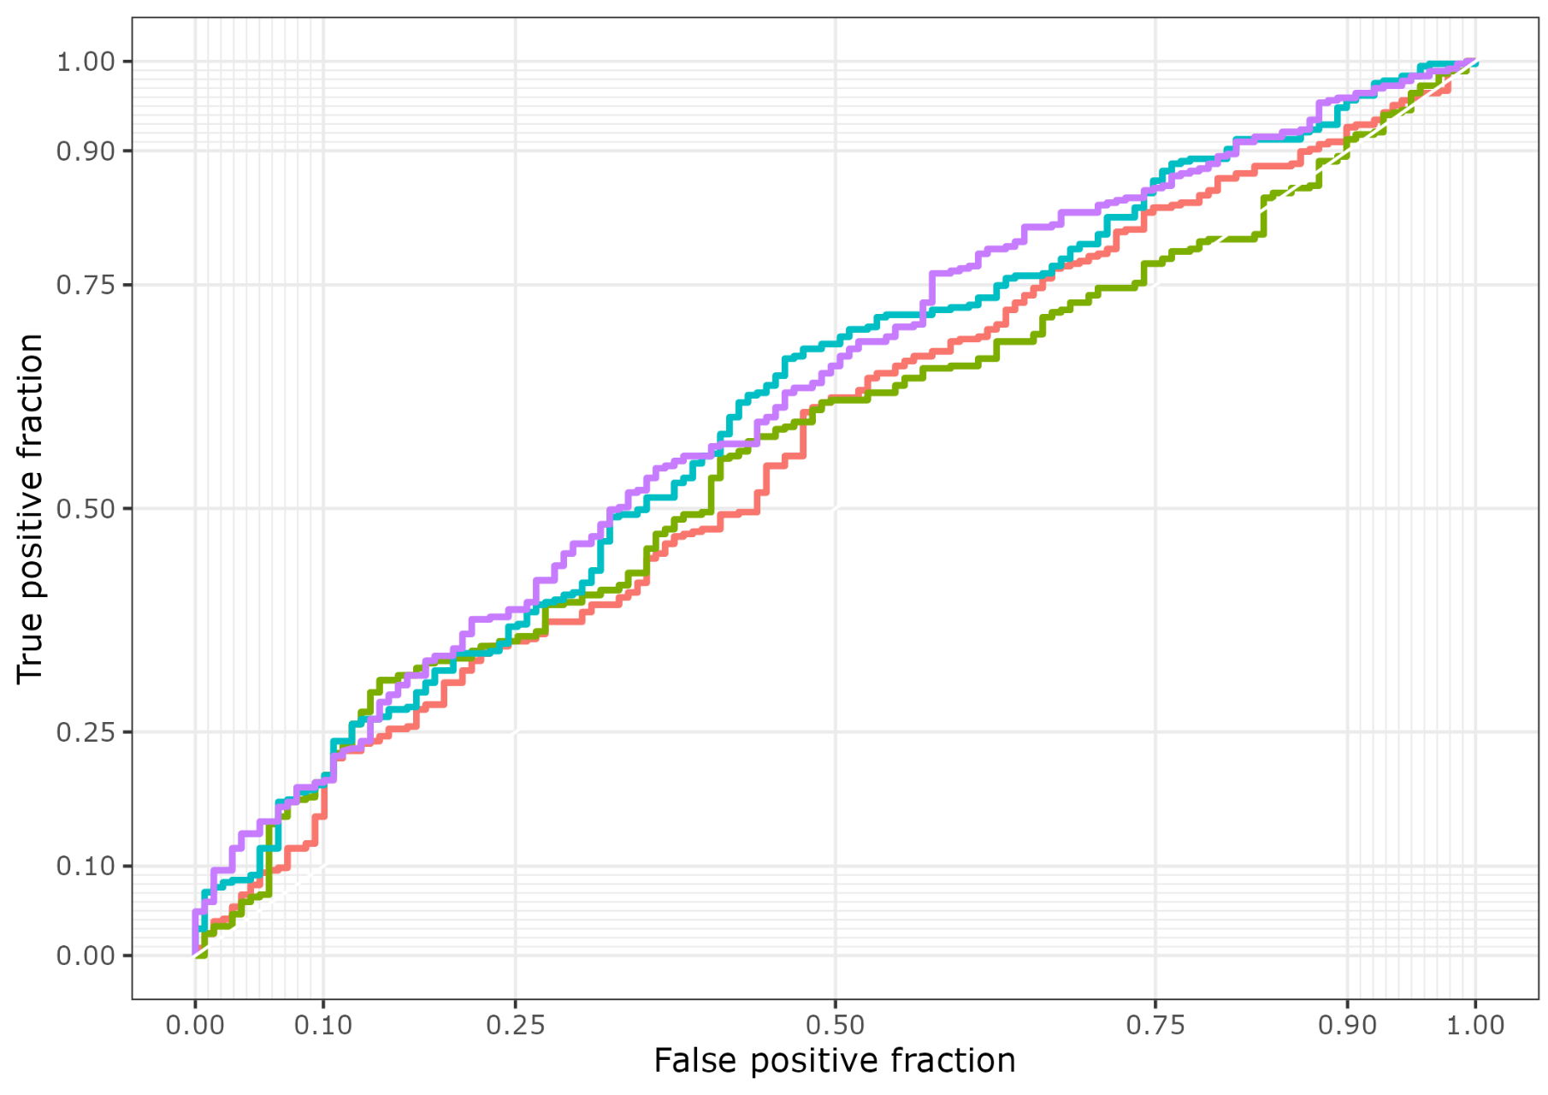
CAS
EAS
AMR
Supplementary Figure 3b: Polygenic risk score model performance evaluation
The ROC curve depicts an evaluation of the PRS model's performance for each target data population when using the 4 population-specific summary statistics and the multi-ancestry PD summary statistics. Each panel represents a comparison of individual-level data. The true positive rate is plotted on the Y axis against the false positive rate on the X axis. The sensitivity of the model increases with increasing Y value. The specificity (1-specificity) of the model decreases as the X value increases. Each population-specific PRS summary statistics is represented as a curve.

Slide 6
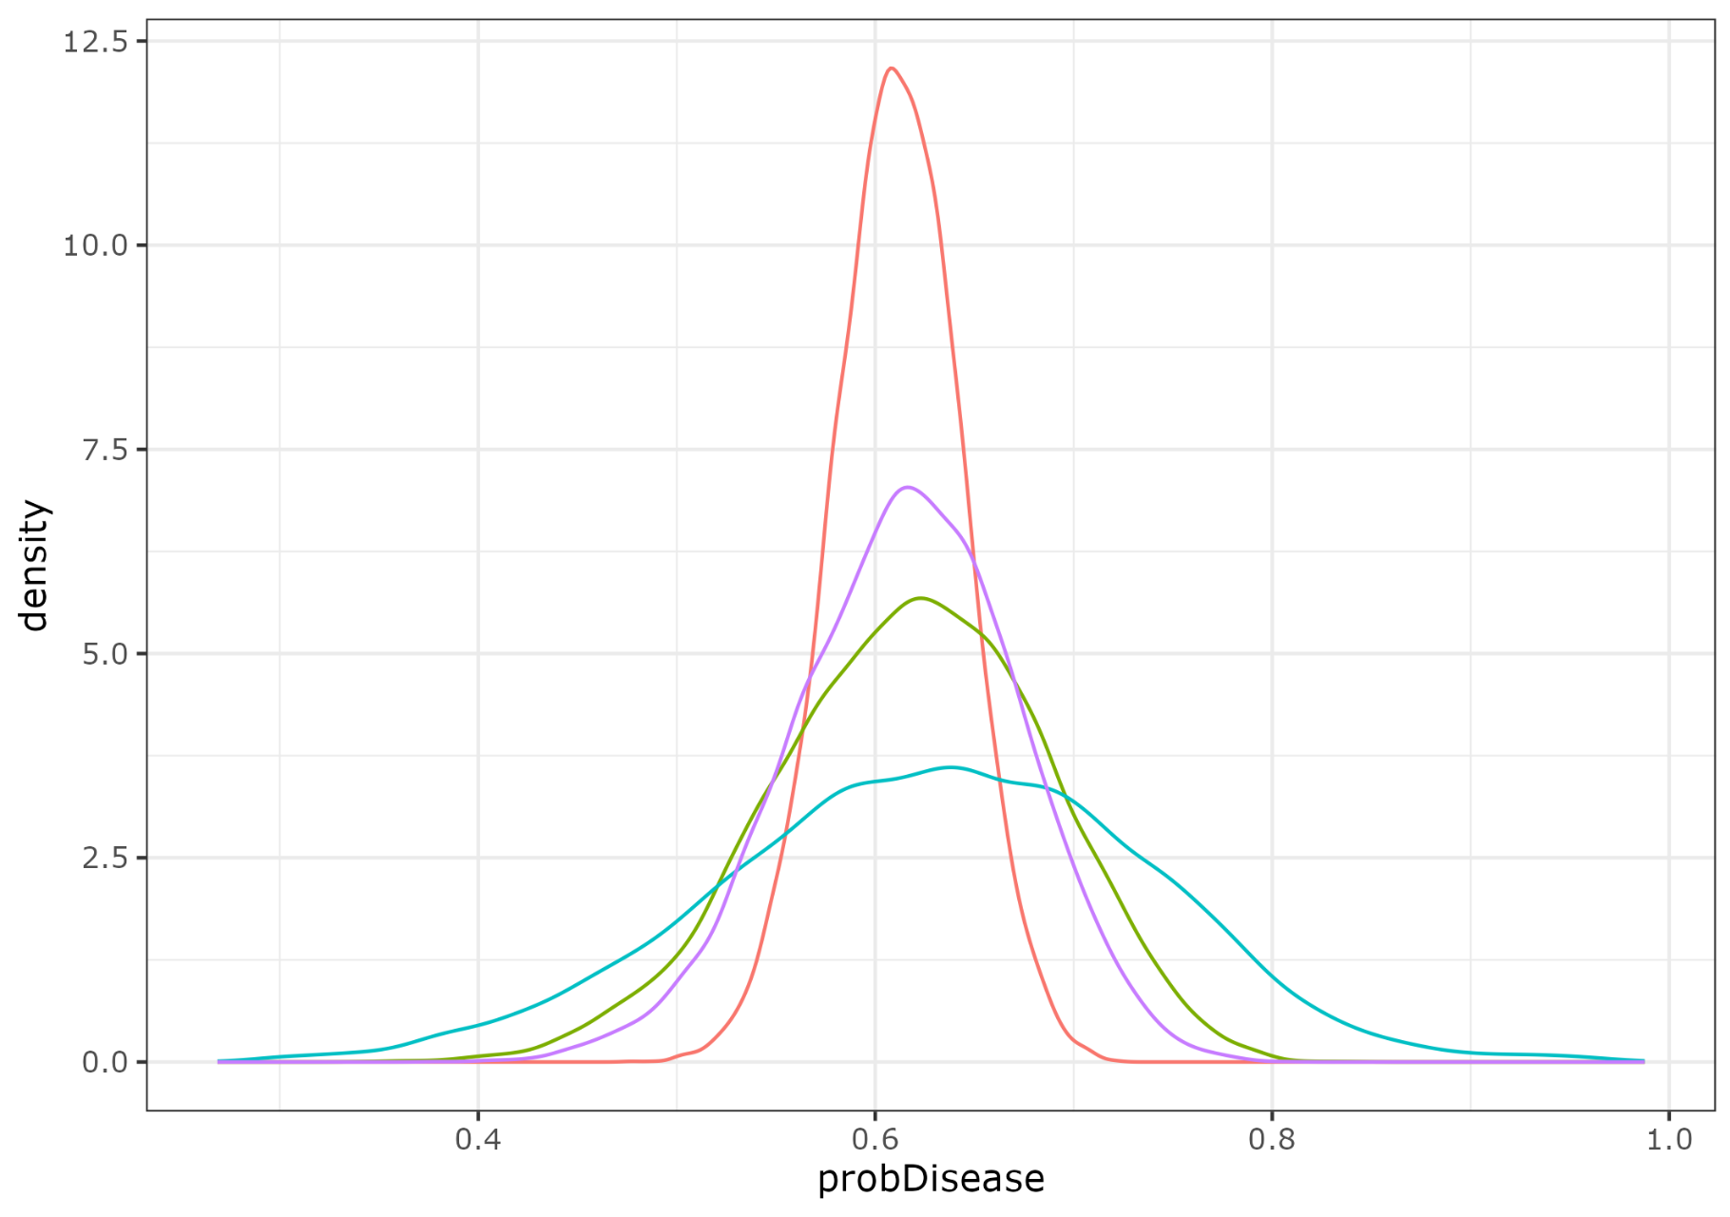
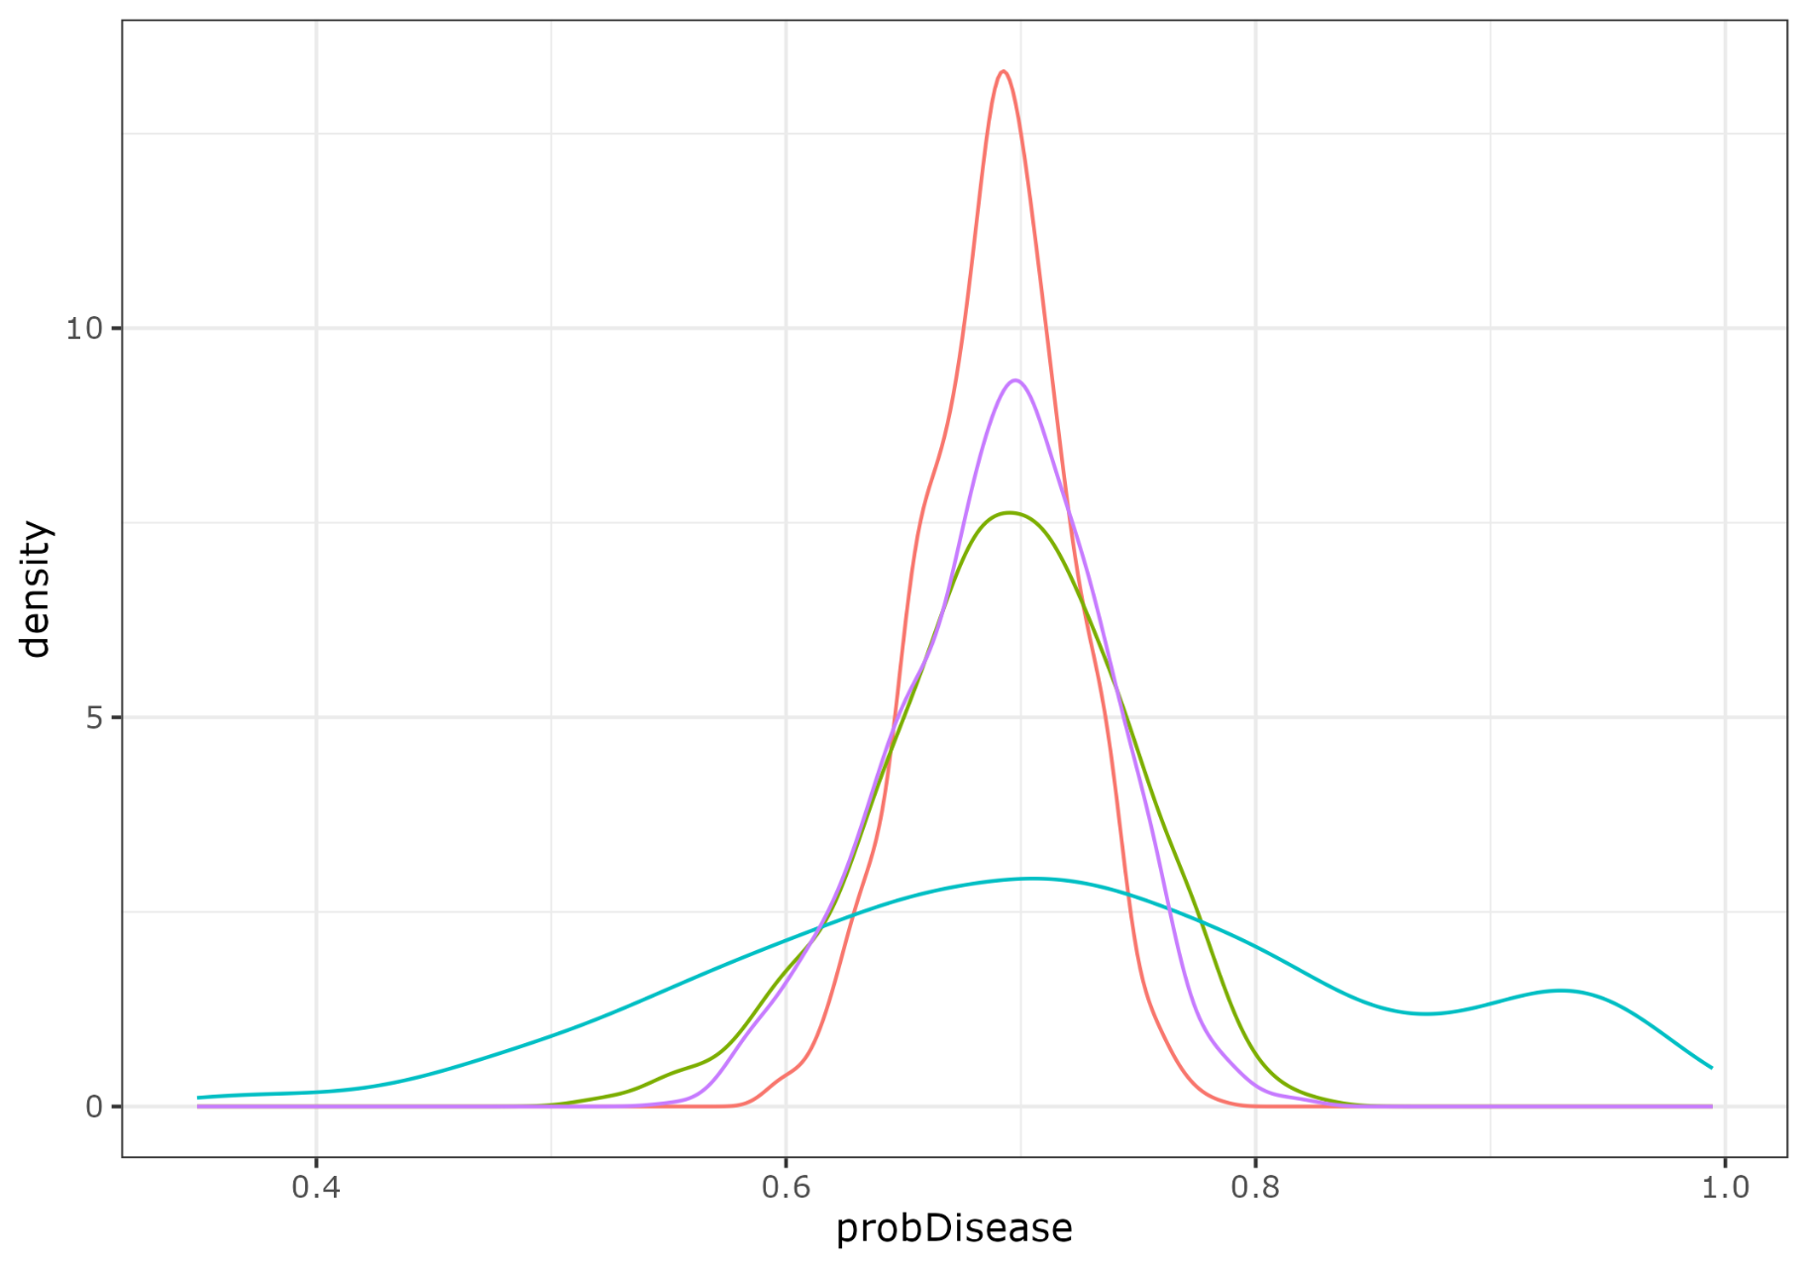
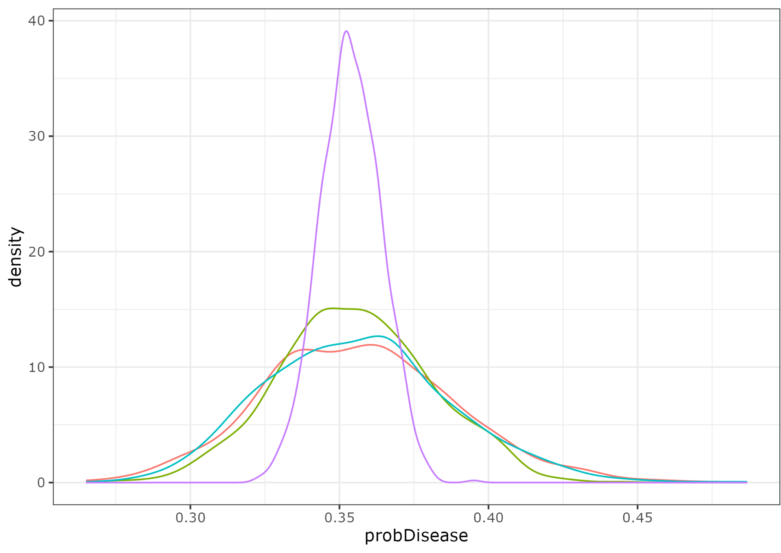
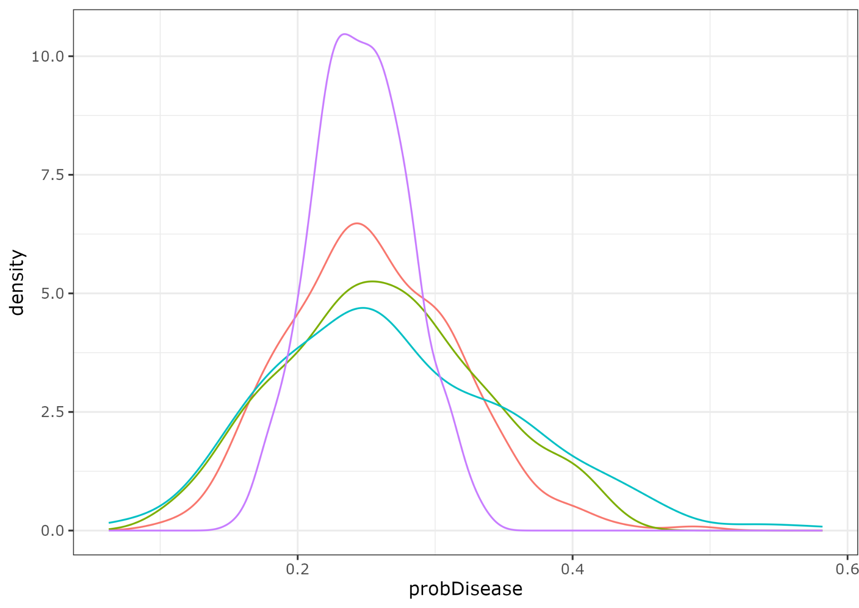
EUR
AJ
Supplementary Figure 4a: Density plots comparison for each population. Density plots comparing disease probabilities for each target data using four distinct summary statistics. Each panel represents a comparison of individual-level data. From left to right, the panels depict data from EUR, AFR, AJ, and AAC populations. The Y-axis represents density, while the X-axis denotes disease probability. Each distribution curve is color-coded: AAC is represented by pink, EAS by light green, AMR by purple, and EUR by calypso
AFR
AAC

Slide 7
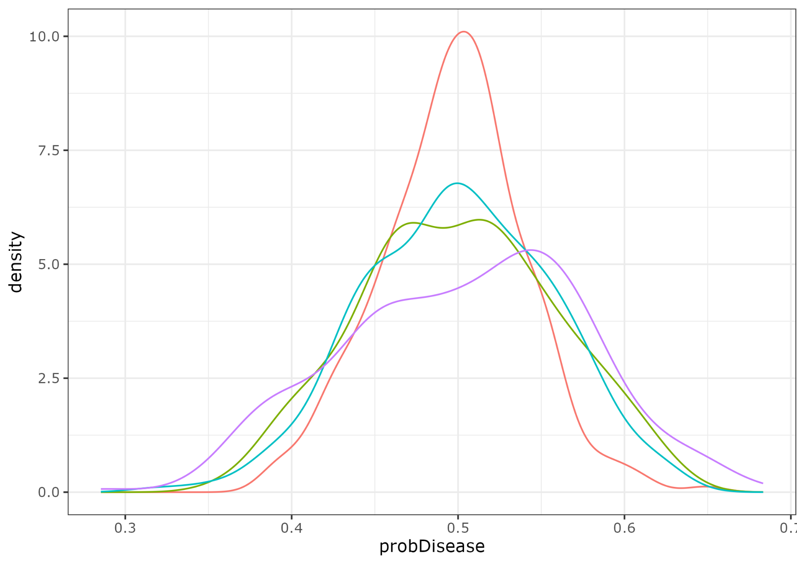
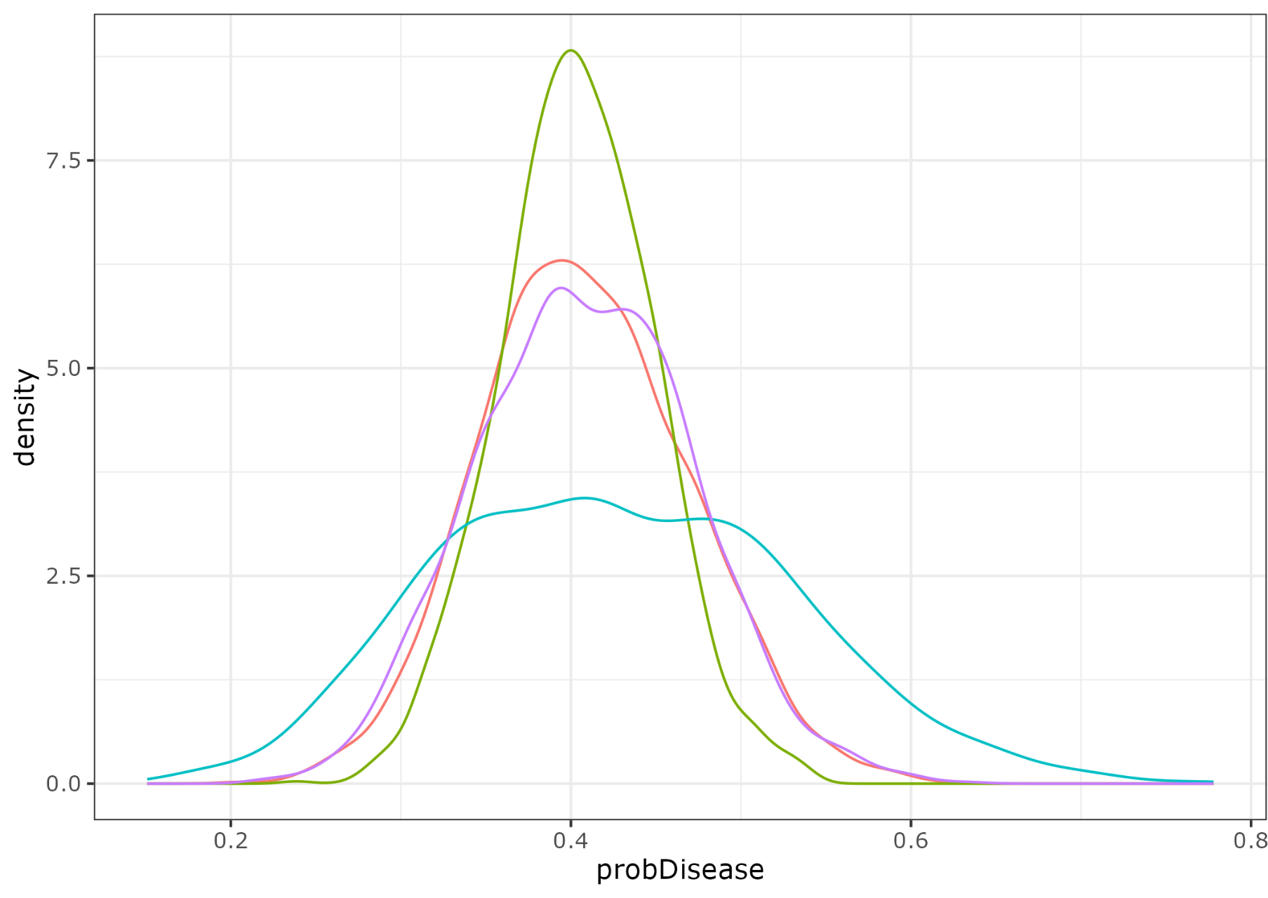
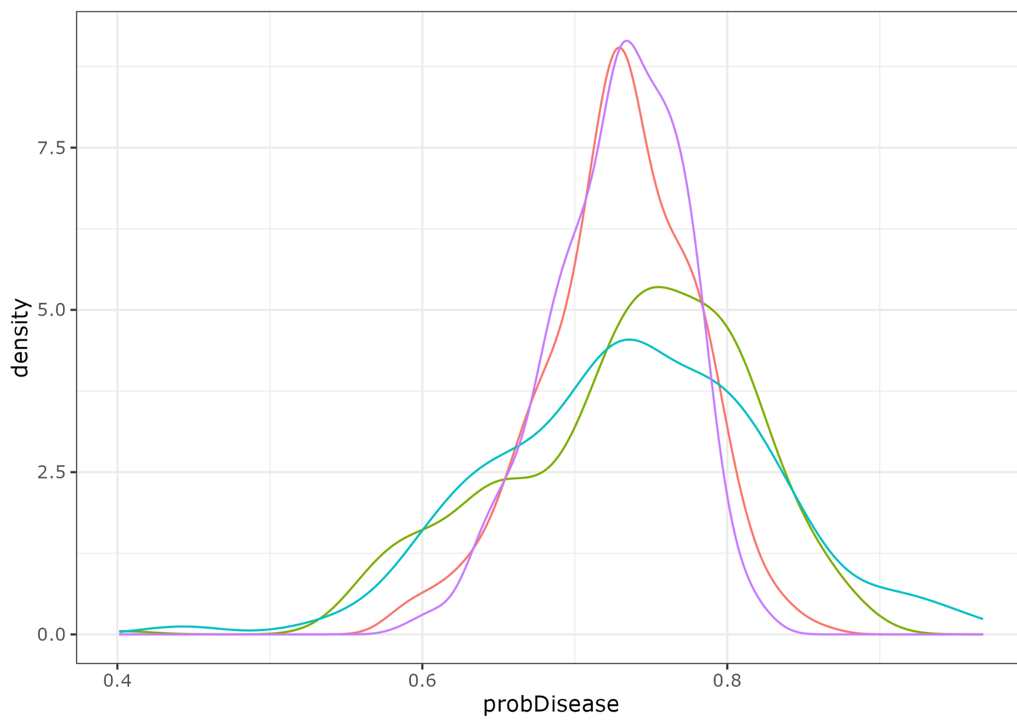
CAS
EAS
AMR
Supplementary Figure 4b: Density plots comparison for each population. Density plots comparing disease probabilities for each target data using four distinct summary statistics. Each panel represents a comparison of individual-level data. From left to right, the panels depict data from CAS, EAS, and EUR populations. The Y-axis represents density, while the X-axis denotes disease probability. Each distribution curve is color-coded: AAC is represented by pink, EAS by light green, AMR by purple, and EUR by calypso

Slide 8
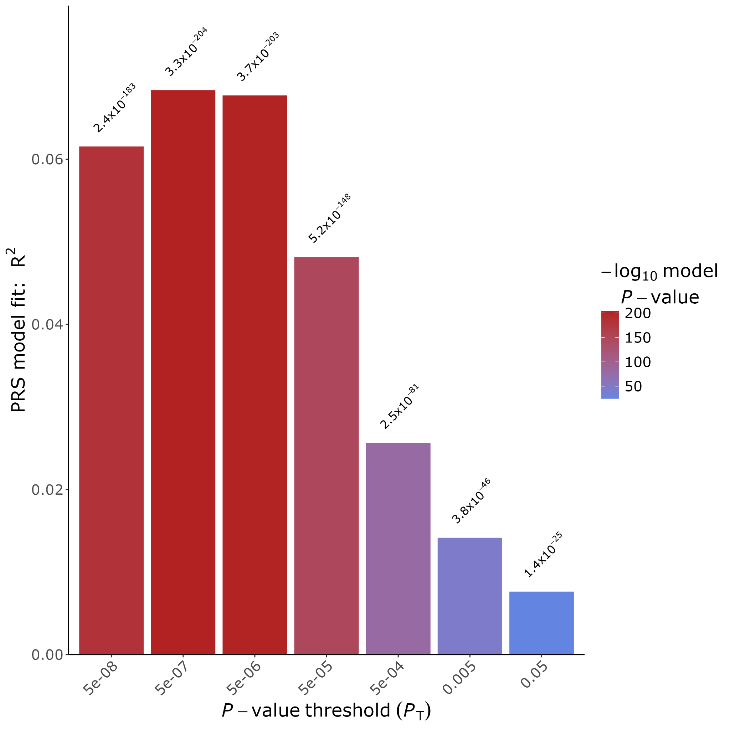
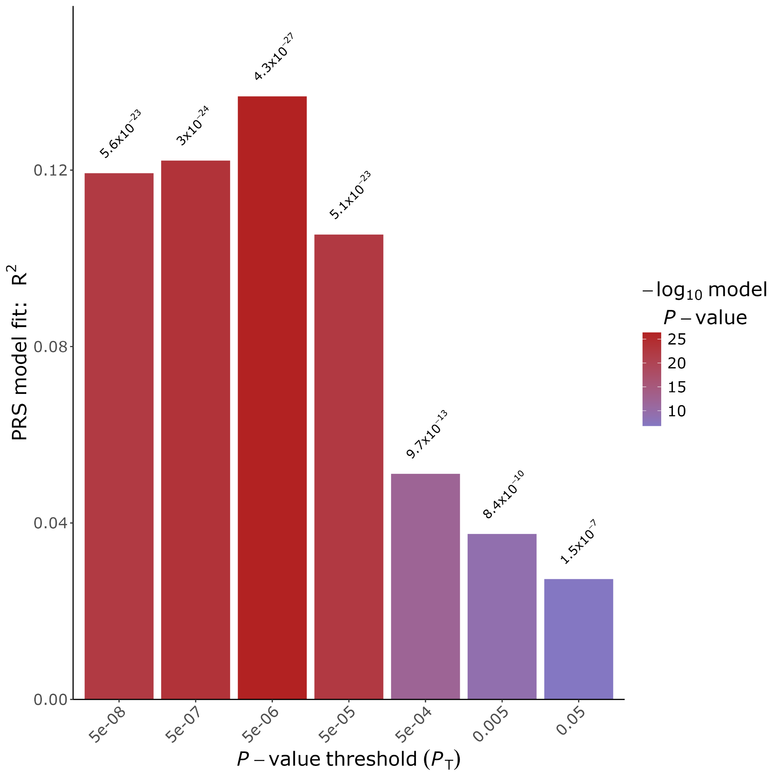
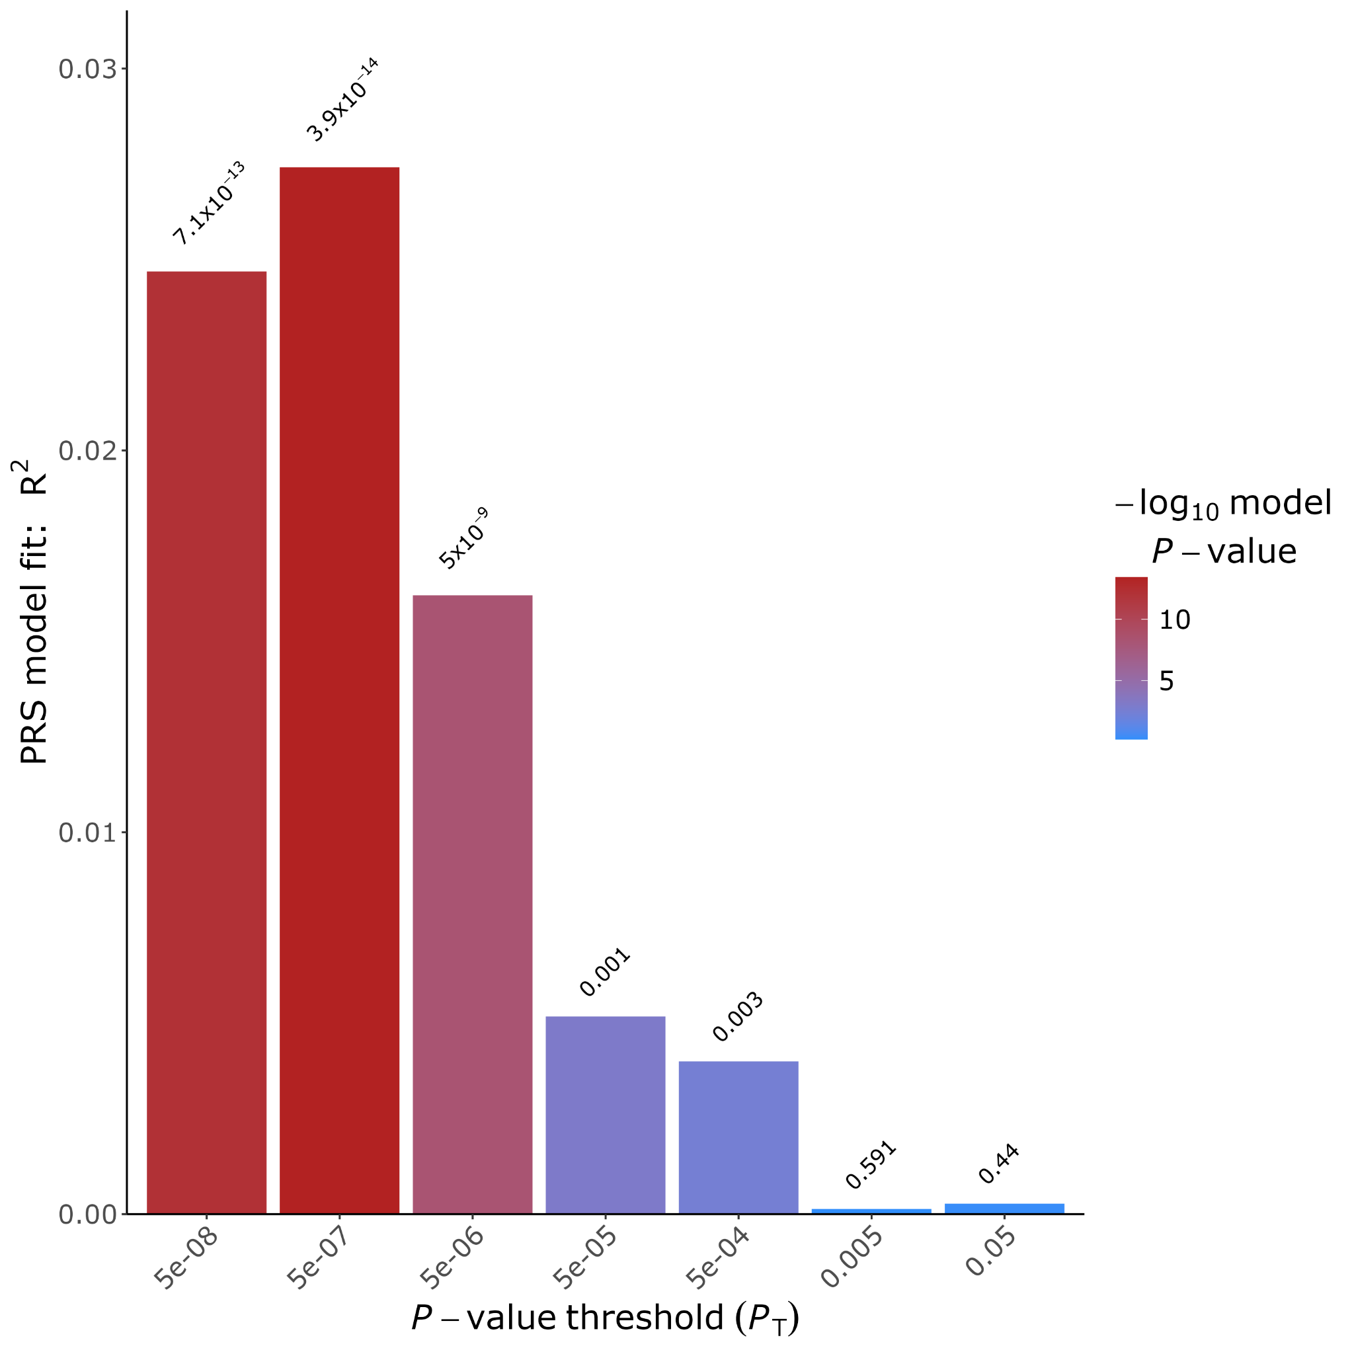
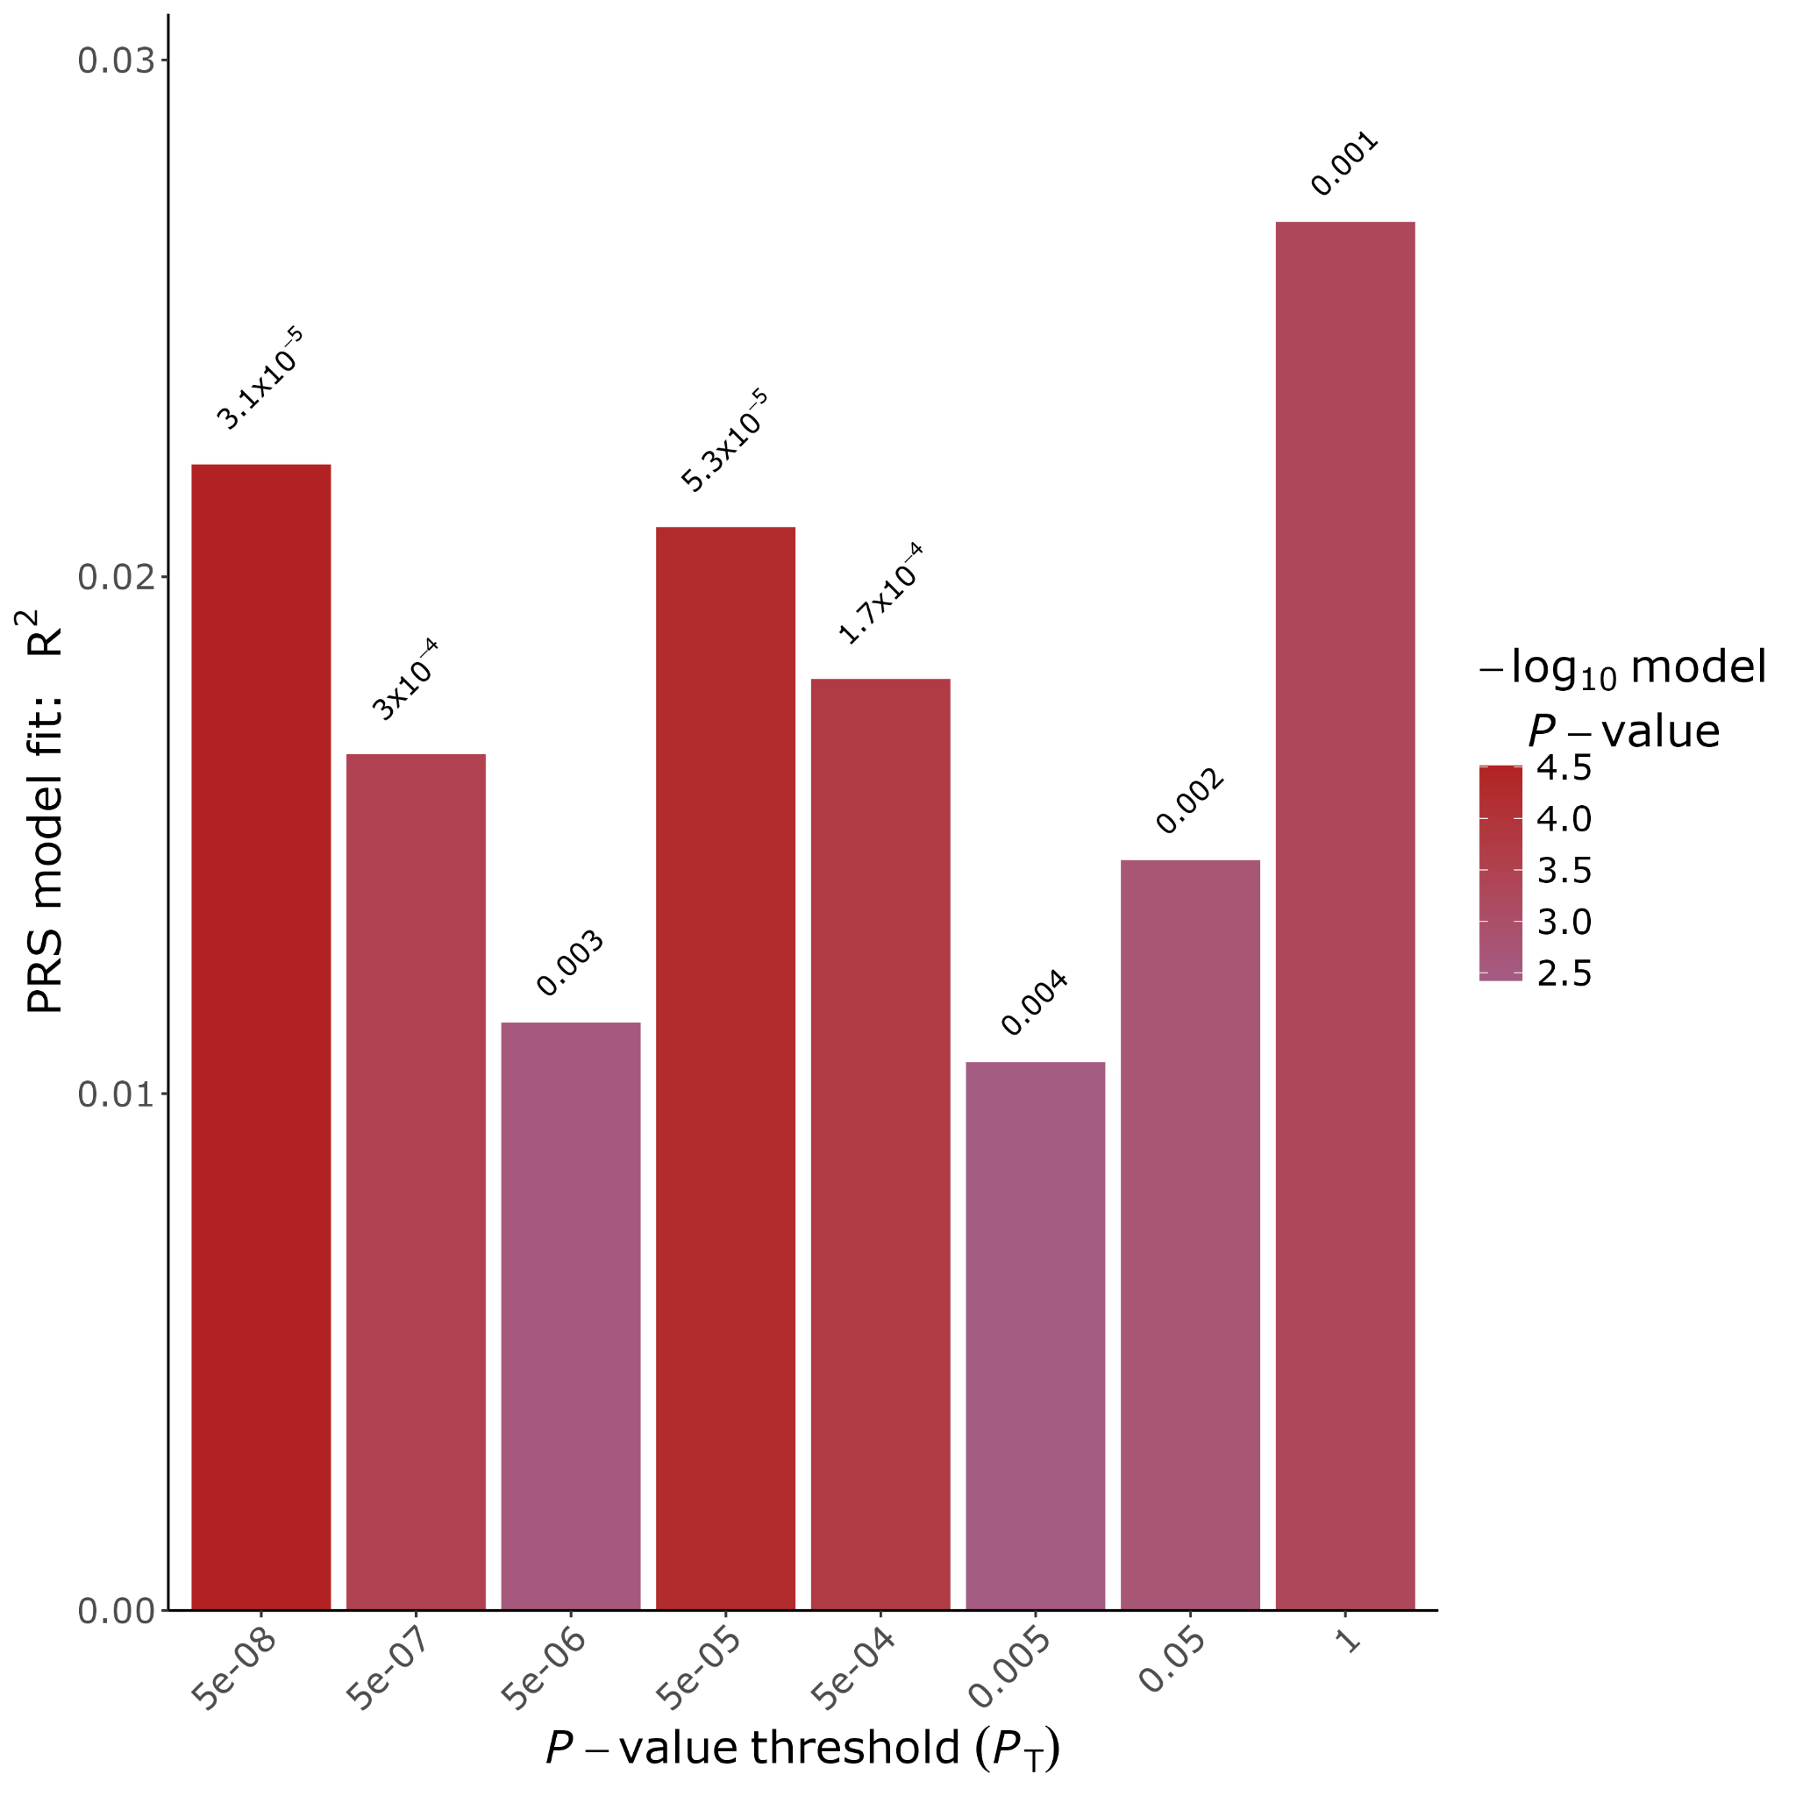
EUR
AJ
Supplementary Figure 5a: Multi-ancestry PRS bar plot representing an assessment of the PRS model's performance by p-value thresholding. The PRS Model Fit R^2 is plotted on the Y axis against the P-value Threshold on the X axis.
AFR
AAC

Slide 9
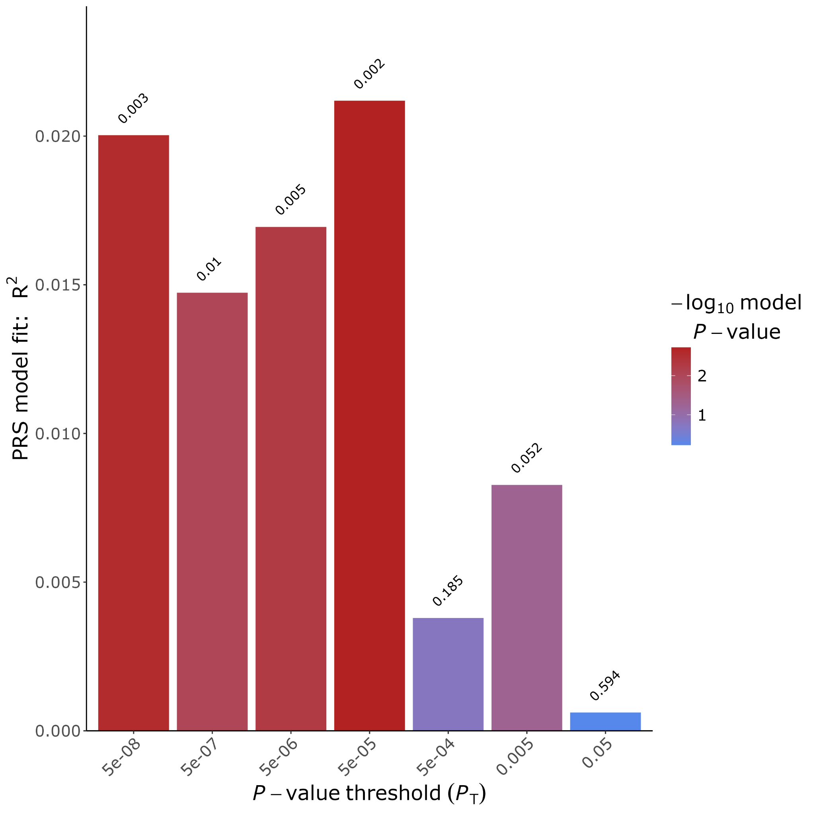
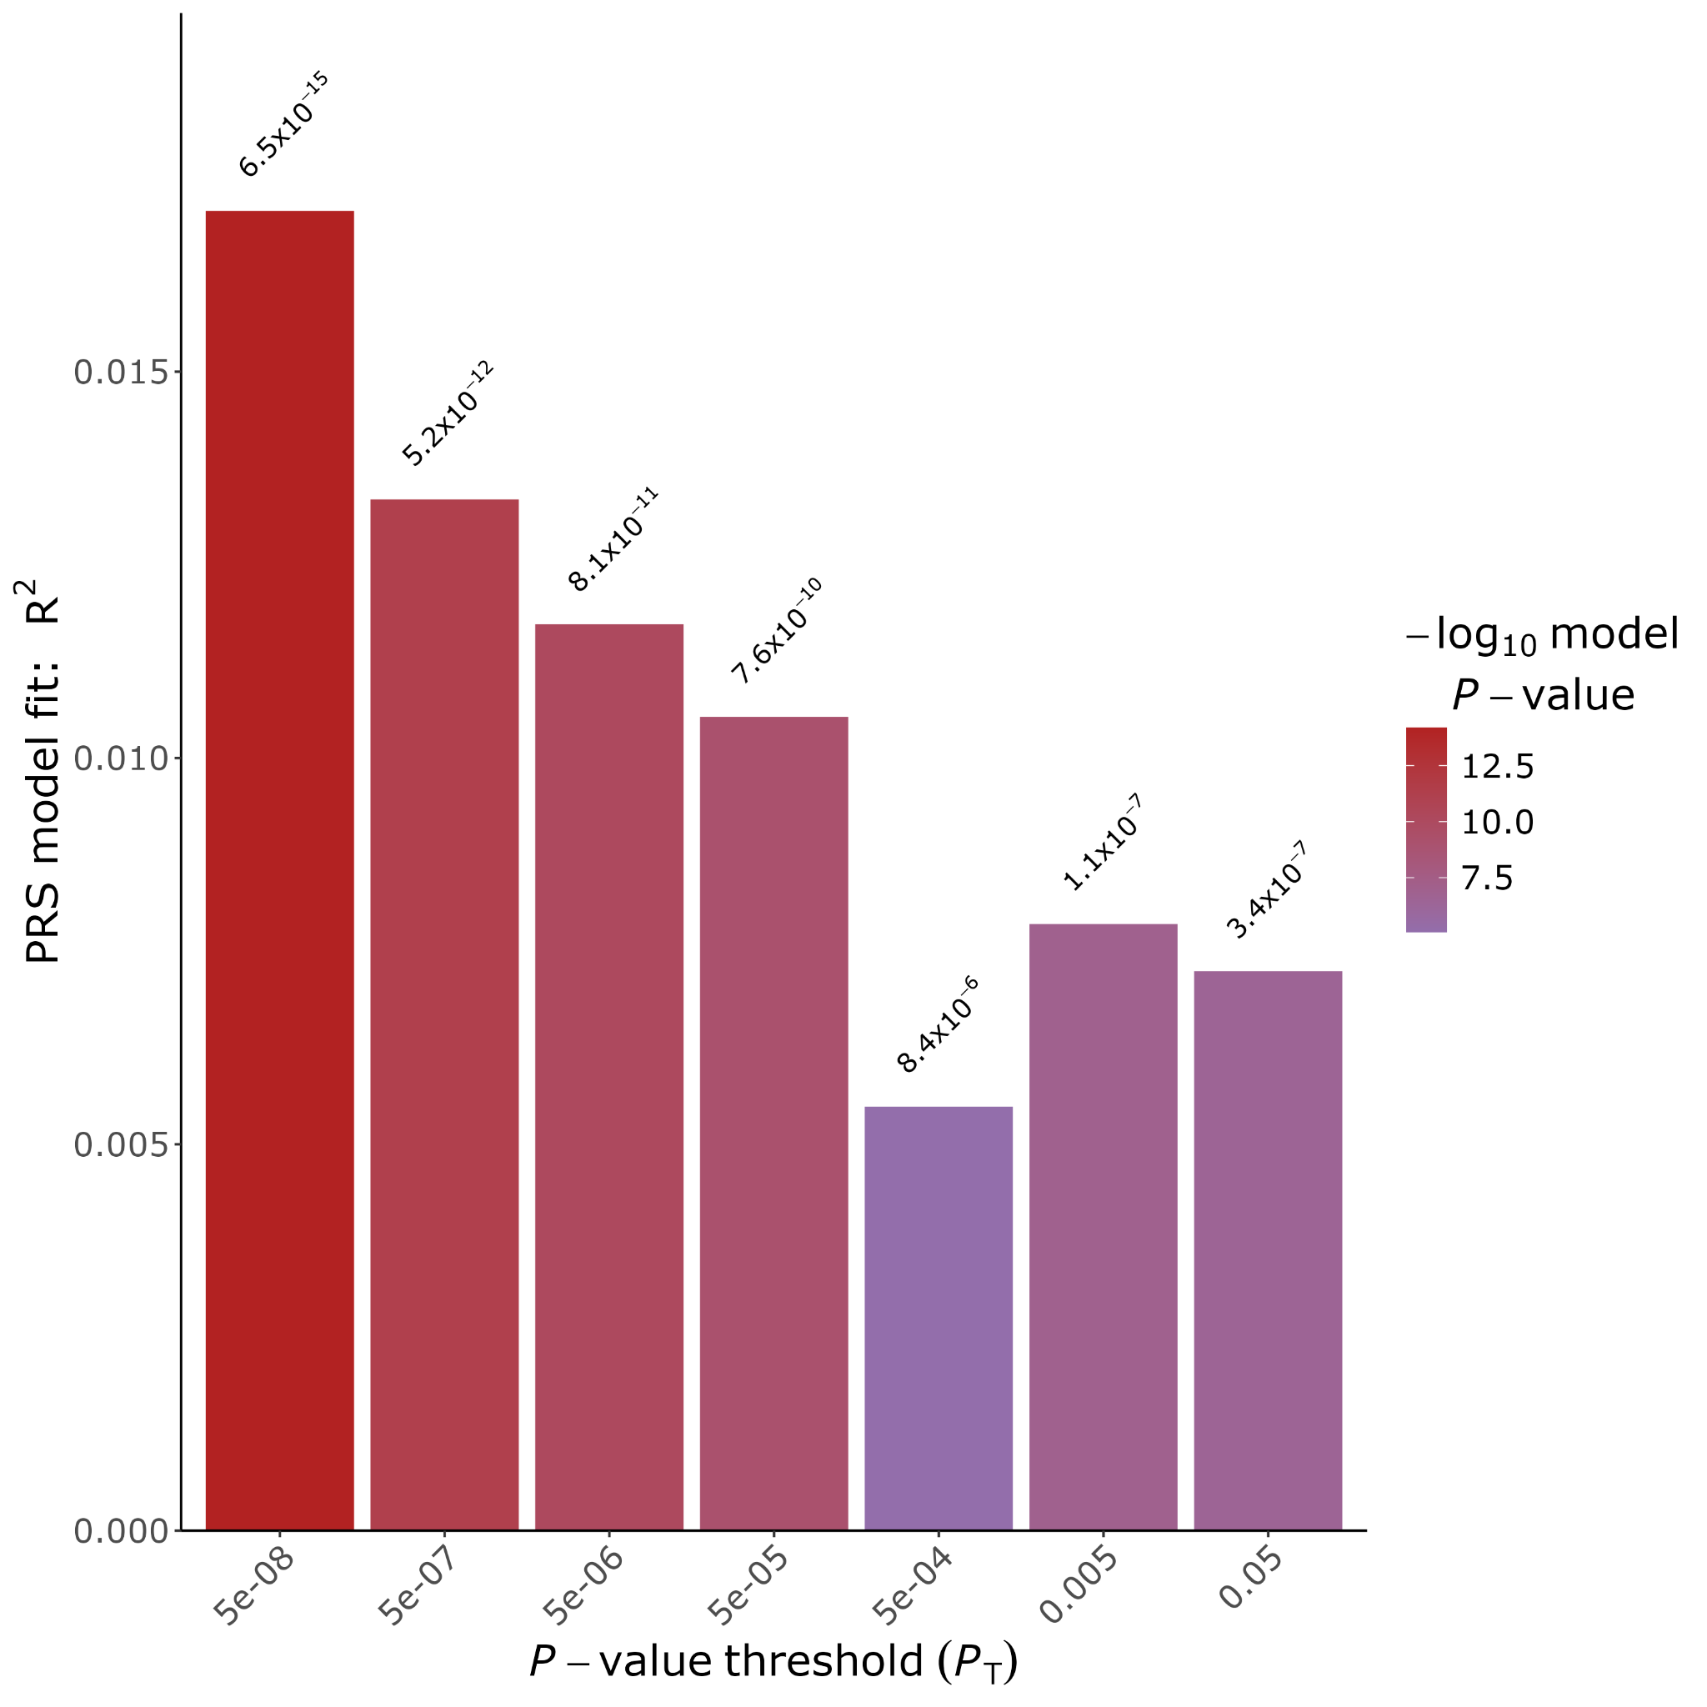
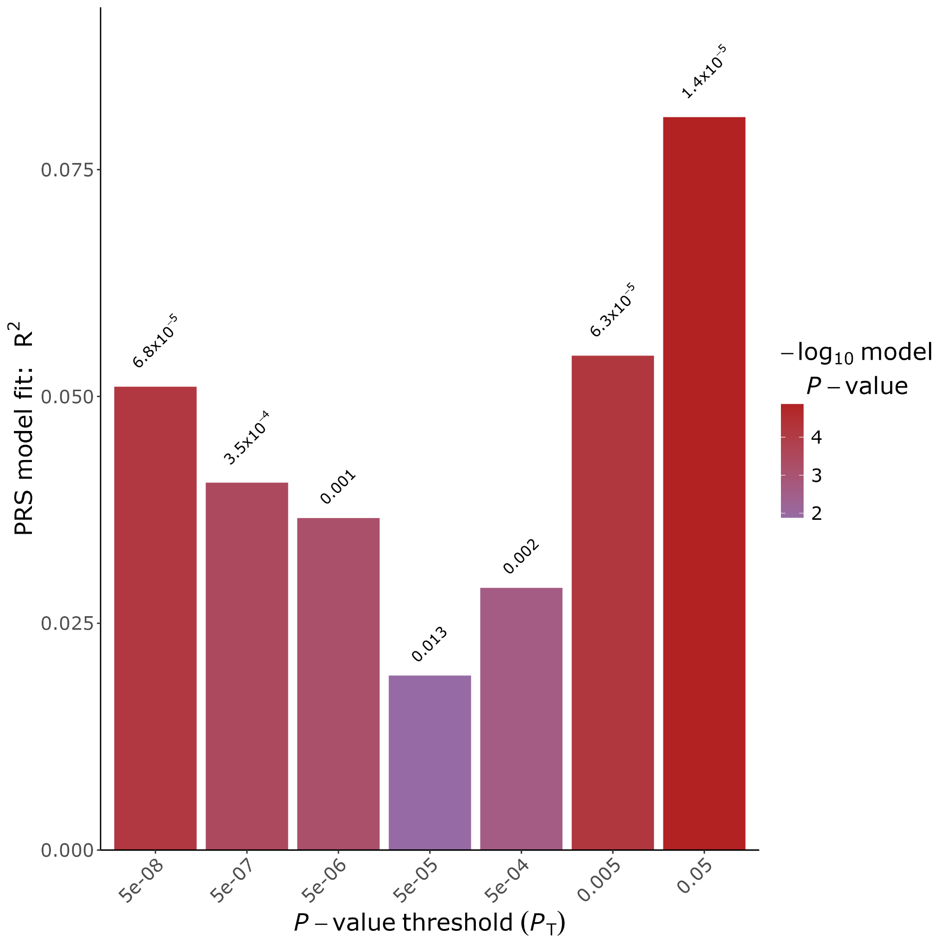
CAS
EAS
AMR
Supplementary Figure 5b: Multi-ancestry PRS bar plot representing an assessment of the PRS model's performance by p-value thresholding. The PRS Model Fit R^2 is plotted on the Y axis against the P-value Threshold on the X axis.

